Slide 1

Wireless Institute of Australia (WIA)
x
Presented by Paul VK5PAS, WIA Director

Slide 2
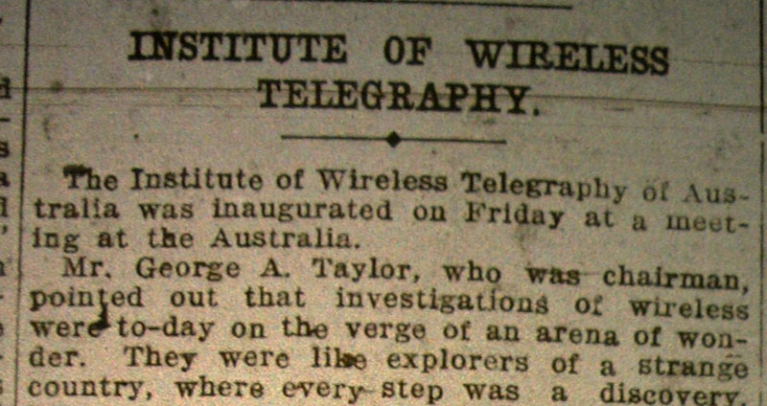
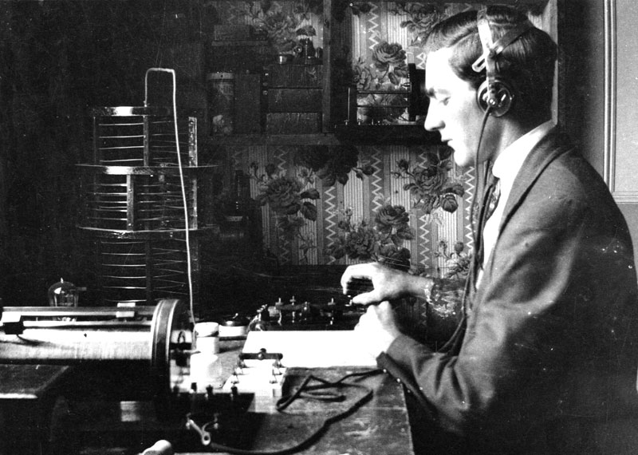
History
Among the earliest Wireless Telegraphy organisations
Formed in 1910
  First meeting 11 March 1910 NSW
  The Institute of Wireless Telegraphy of Australia
Sept 1919 South Australian Wireless Institute formed
2004 – disolution of State Divisions. Single National body formed
2010 - Centenary

Slide 3
Objects of the WIA
To promote, advance and represent in any way it thinks fit amateur radio and the interests of radio amateurs, and without limiting the generality of the forgoing
To protect and enhance the priviliges of radio amateurs
To encourage an awareness of the value of amateur radio
To educate and encourage potential radio amateurs
To represent radio amateurs both nationally & internationally
To provide services for radio amateurs and those interested in amateur radio, including the publication of the magazine ‘Amateur Radio’ and other publications

Slide 4

ASIC/Corporations Act
Company Limited by Guarantee
  Non-profit (Not-for-Profit)
  Company limited by guarantee with annual (or consolidated) revenue of less than $1 million
Revenue $517,569 (2015). Trading loss $12,680.00.
  2 major costs: Staff costs, AR magazine printing/production/posting
Bound by the Corporations Act 2001.
  6 volumes
Administered by Australian Securities and Investments Commission (ASIC)
Many legal restrictions & requirements
Constitution

Slide 5

Structure
Board of Directors
  President, Phil VK2ASD
  Vice President, Fred VK3DAC
  Director, Ewan VK4ERM
  Director, Robert VK3DN
  Director, Roger VK2ZRH
  Director, Paul VK5PAS
  Director, Andrew VK6AS
Secretary
  Jim VK3PC
Notes:
The Wireless Institute of Australia is managed by a board of seven Directors, plus a Secretary and Treasurer.

Slide 6
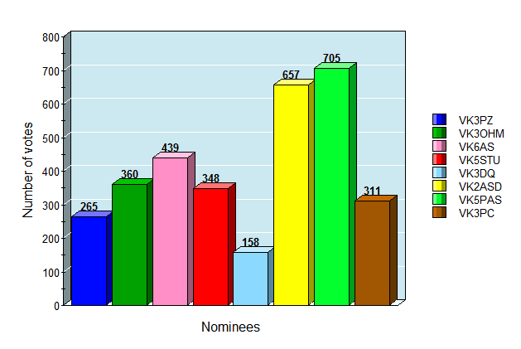
2016 WIA Election
Notes:
Nominations:- VK5STU, VK3DQ, VK3OHM, VK3PC, VK3PZ, VK5PAS, VK6AS, VK2ASD

Slide 7
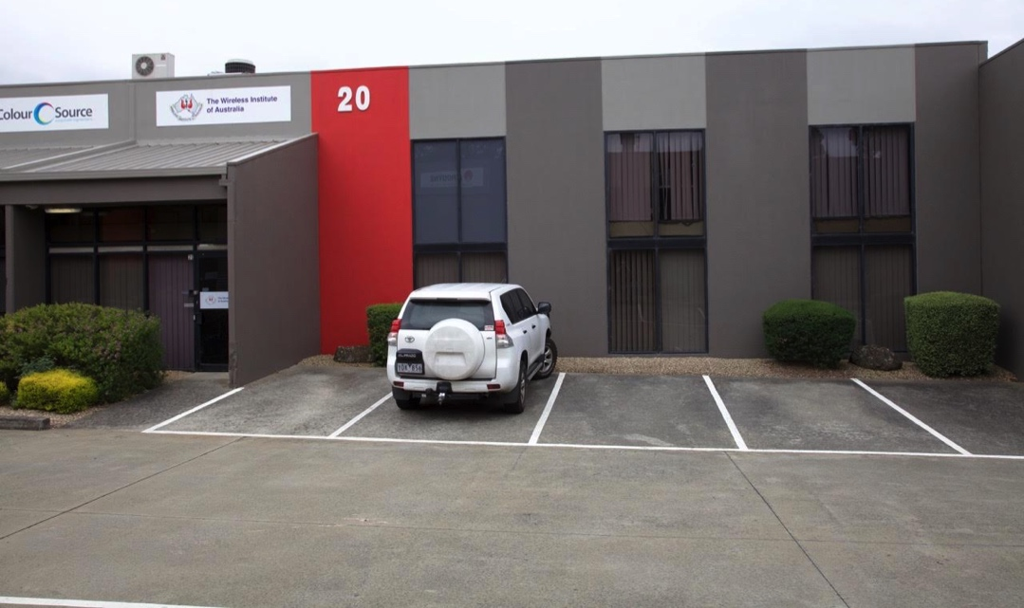
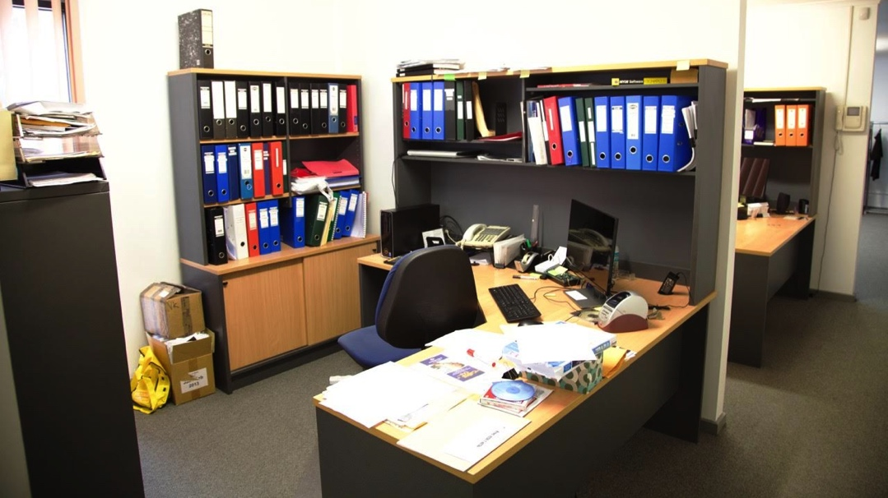
Structure
Treasurer
  Murray Leadbetter
  (Accountant)
Executive Director
  Bruce Deefholts
Examinations Officer
  Petra
Committees
Volunteers
National office
  Bayswater, VIC

Slide 8

Communication between Directors
Teleconference every month
  GoToMeeting
  3 hours
Regular phone calls & emails

Slide 9
Communication with members
Visits to local radio clubs
Broadcast
AR magazine
WIA Board newsletters
  Distributed by the WIA Board of Directors following their monthly board meetings
Presidents blog
  Monthly
  AR magazine
  website

Slide 10
Committees
Spectrum Committee
  Regulatory sub-committee
    ACMA, ITU, Govt specialist
  Repeaters, Beacons & Frequency co-ordination sub-committee
  Standards, Interference & EMR sub-committee
  IARU Monitoring Service sub-committee
  Technical Advisory (TAC) sub-committee
Administrative & Financial Committee
Affilliated Club Committee
Notes:
Admin & Financial Committee is concerned with the day to day running of the WIA, the efficient operation of the WIA office and the WIA’s financial management.

Slide 11
Committees
Communications, Marketing & Publications
  WIA Marketing sub-cmmittee
  Publications sub-committee
  Publications Committee
  AR advertising sales sub-committee
  Broadcast website & Social media sub-committee
  AGM sub-committee
Education Committee
Community Services Committee

Slide 12
Committees
Radio Activities Committee
  Contests sub-committee
  Awards sub-committee
  Amateur Radio Direction Finding (ARDF) sub-committee
  ARISS sub-committee
  QSL card sub-committee
Historical & Archives Committee
New Initiatives Committee
IT Services Committee

Slide 13
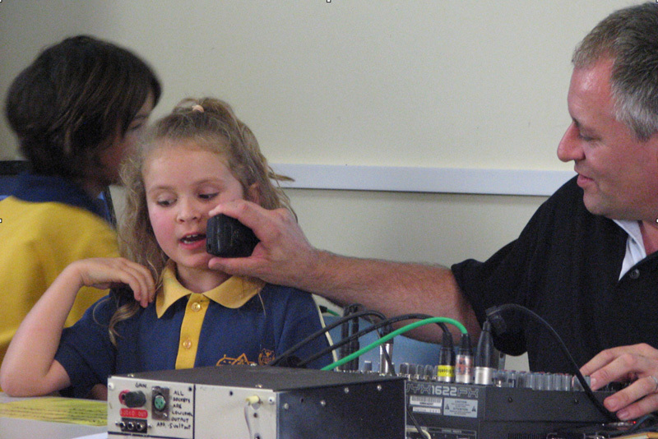
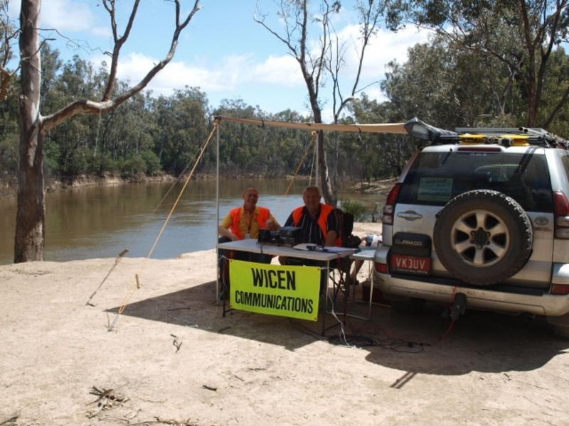
Volunteers
AMSAT
AR/pubcom
ARDF co-ordinator
ARISS co-ordinator
WIA Awards
Club co-ordinator
Contest Managers
Exams service
Historian
News Broadcast
Technical Advisory (TAC)
QSL Bureau
Webmaster
WICEN

Slide 14

WIA – working for you
Advancing & protecting our privileges
Protecting our spectrum
Licence exams and certificates
Callsigns
National news service
Notes:
Member advocacy - tower legislation

Slide 15

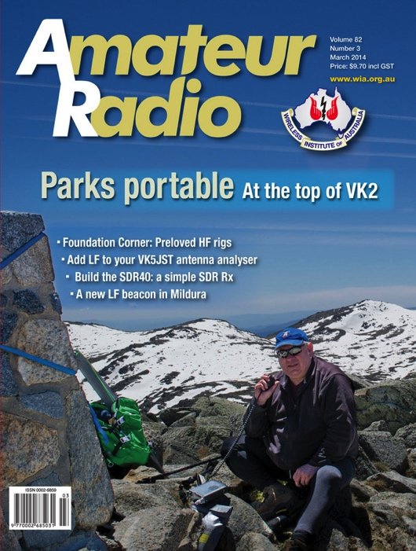
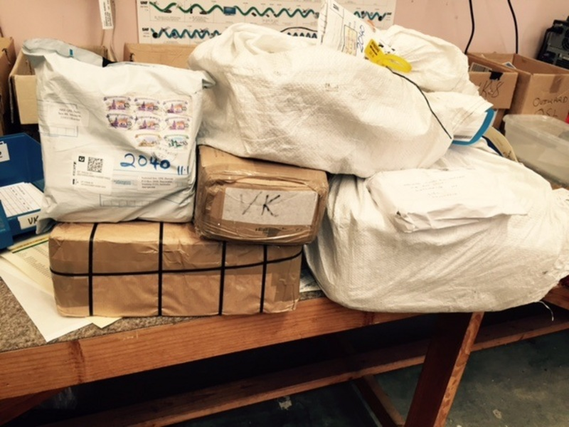
WIA Membership benefits
Amateur Radio (AR) magazine
Annual Callbook
WIA Bookshop
QSL service
Awards
Contests
Support for your local club
  WIA Grants scheme
Club liability Insurance

Slide 16
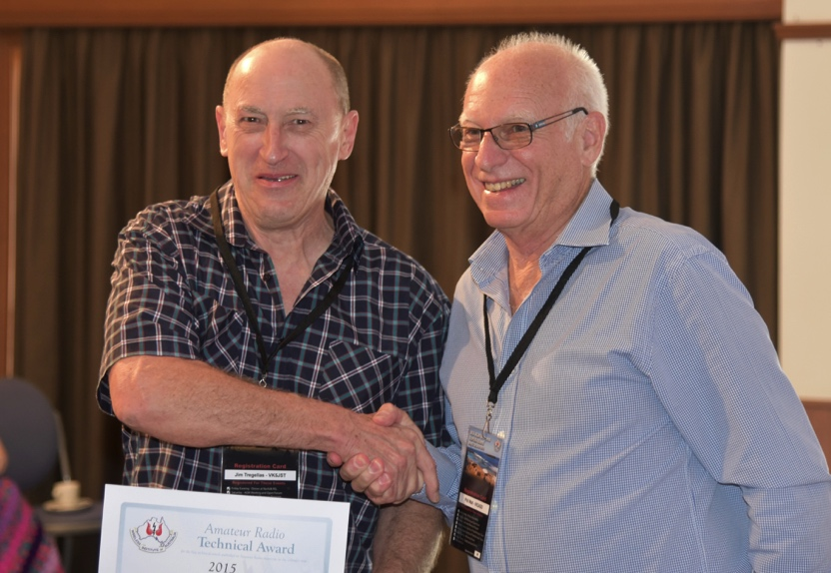
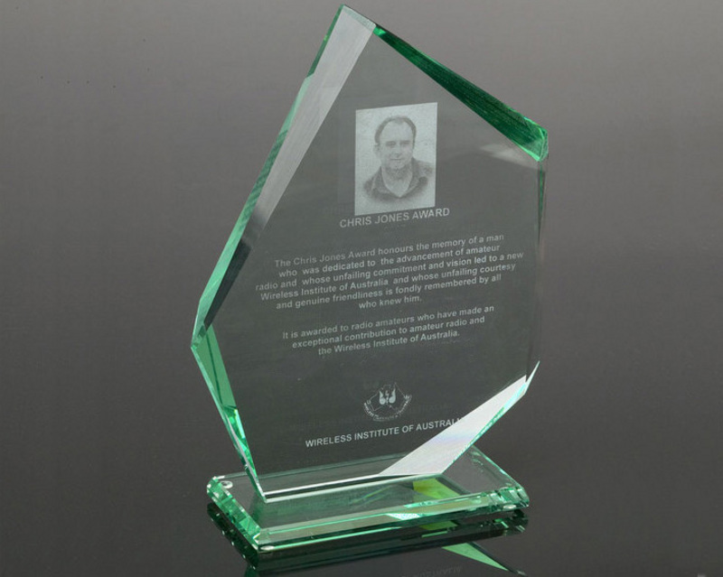
Merit Awards
GA Taylor Medal
Chris Jones Award
Ron Wilkinson Achievement Award
WIA Technical Excellence Award
Presidents Commendation
Al Shawsmith Award
Higginbotham Award
Technical AwardFoundation Award
Michael Owen Award
Full details on wia website
  Including nomination forms

Slide 17

Submission to ACMA
Enabling use of digital modes for Foundation
Access to more bands for Foundation & Standard
Relaxing permitted bandwidths for all licence grades
Removing mode restrictions
Enabling DIY construction for Foundation
Review of Foundation call signs
Increased maximum power for all licences
Early access to the 5.3 MHz (60m) band
Notes:
The WIA has been a strong advocate for amateur radio during the Federal Govt’s Spectrum Review process, lodging numerous submissions and attending meetings with both the Department and the ACMA. Recently the Minister announced the formation of an entirely new Radiocommunications Act, fundamentallly changing the way spectrum is administered in Australia

Slide 18
The year ahead
Corporate governance training
  Conflict of interest, material personal interests
Visits to clubs
Future amateur licence conditions
  Proposal to ACMA
Office procedures
  Auto generated email
Social media
  Facebook
National Skills Week Aug 29-Sep 4
  High altitude balloon, satellite
STEM/STEAM – young Australians

Slide 19


The year ahead
Review of the WIA Constitution
  Formation of Constitution Review Committee
Membership retention & recruitment
Committee review process.
Promotional video
Legal counsel sought

Slide 20
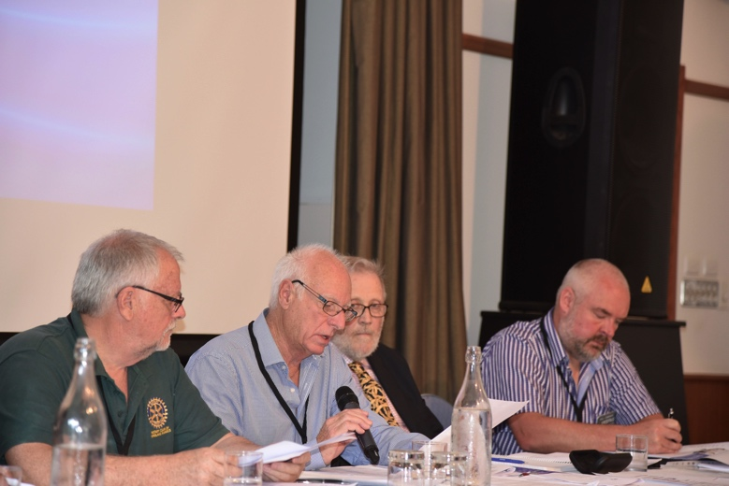
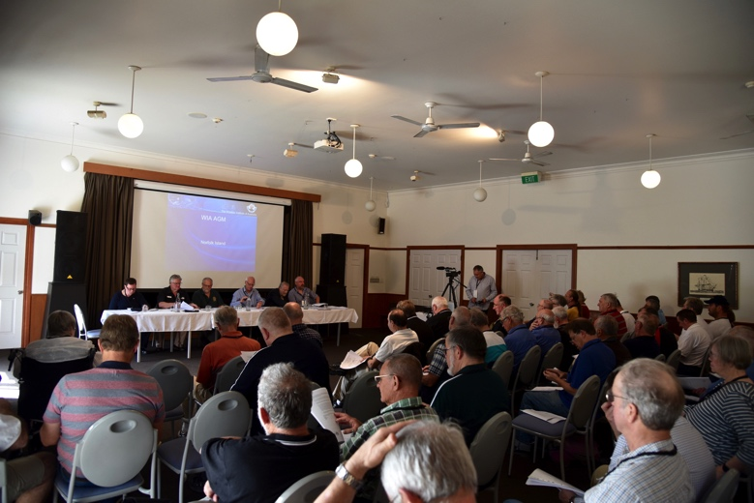
WIA AGM 2016 – Norfolk Island
Fri 27th May – Sun 29th May
Paradise Hotel, Norfolk Island
Friday night dinner –RSL
Saturday –
  AGM
    Presidents report, Silent keys, Financial report
  Dxer of the Year
  Open Forum
  Awards
  Presentations

Slide 21
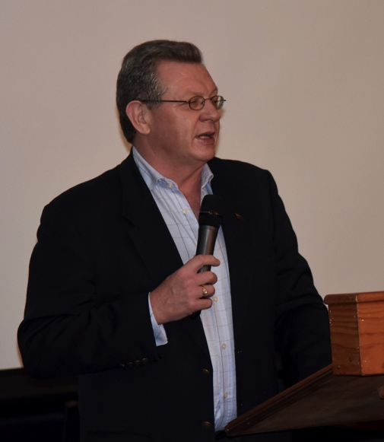
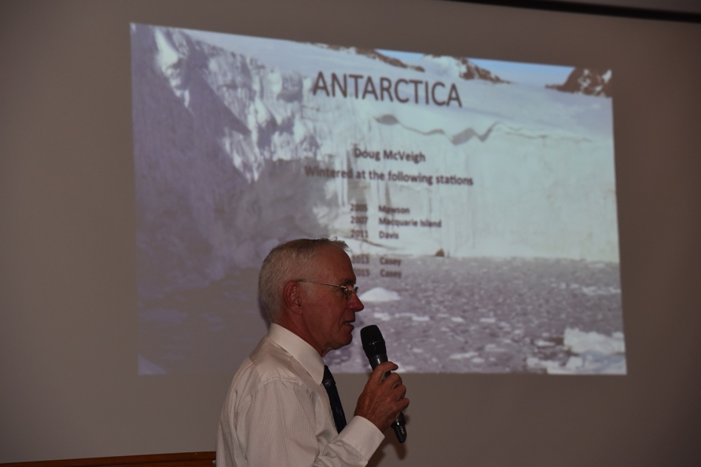
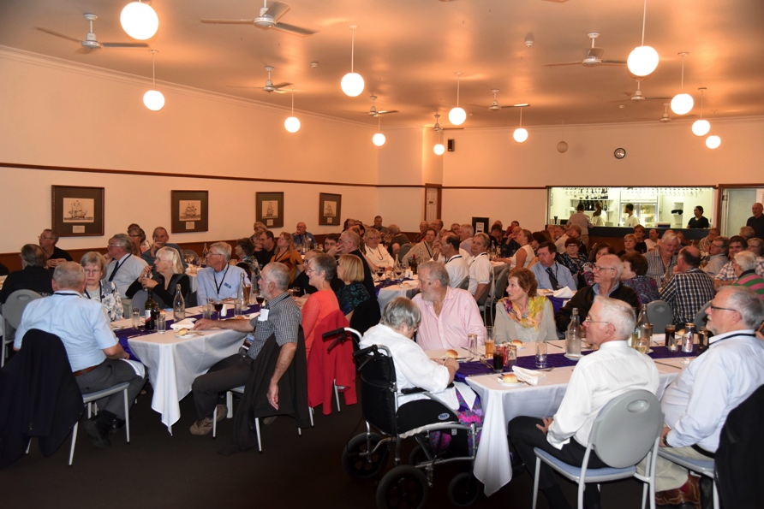
WIA AGM 2016 – Norfolk Island
Saturday night-formal dinner
  Paradise Hotel
  Gary Hardgrave, NI Admin
  Doug McVeigh VK0DMV
  2017 AGM announced

Slide 22
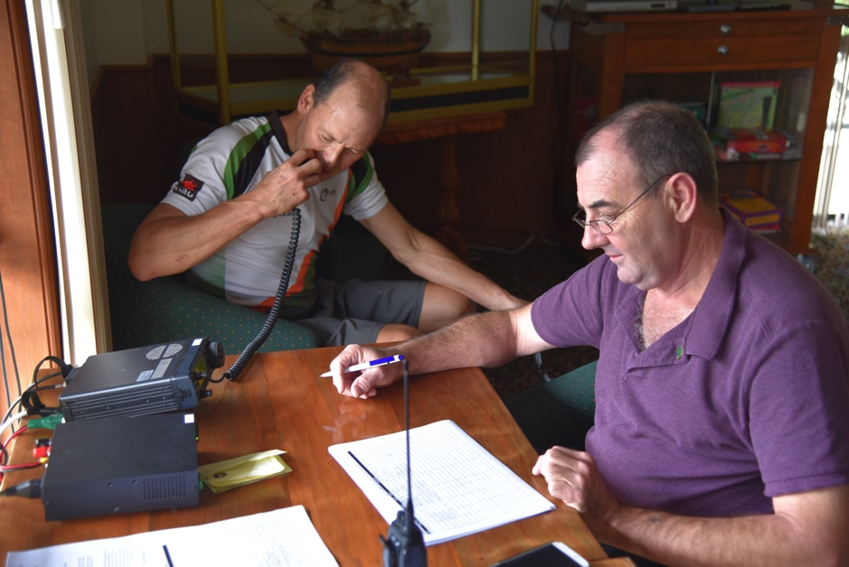
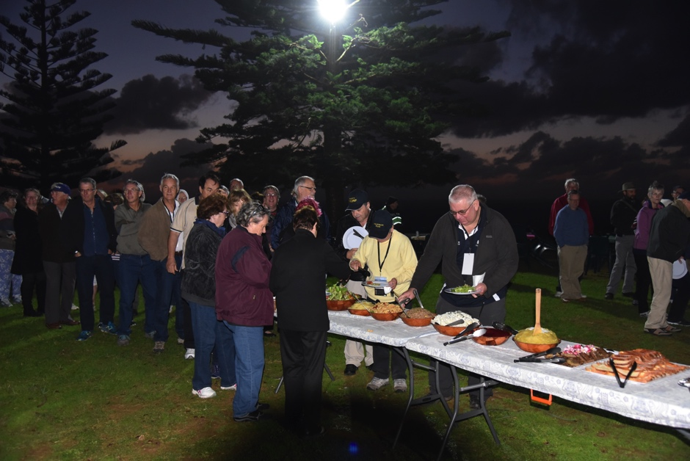
WIA AGM 2016 – Norfolk Island
Sunday – post AGM meeting
  Executive appointments
Sunday evening – Traditional fish fry
Repeater established
VI9ANZAC
Tours
Norfolk Island Award

Slide 23
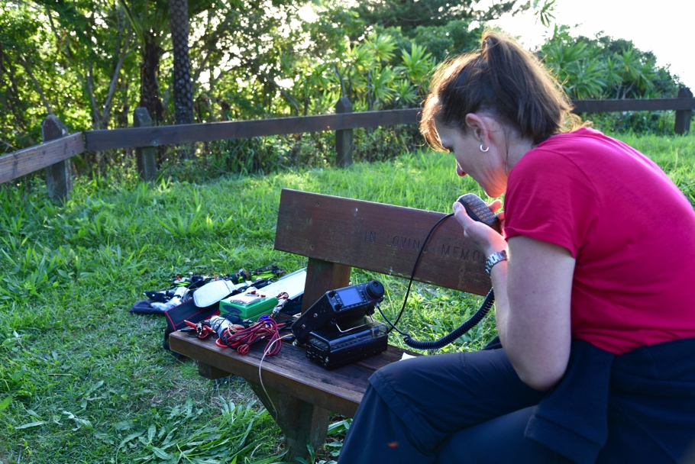

WIA AGM 2016 – Norfolk Island
ALARA
  Kirsty VK9NL
SOTA/WWFF
3.4GHz & 10Ghz
NZART rep
Video taped & Livestream via WIA website
AGM/Open Forum to be posted on WIA website

Slide 24
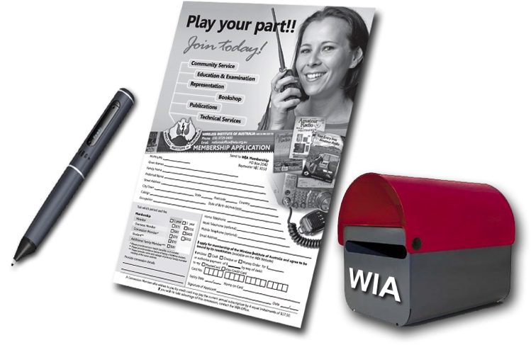
Please consider joining
Online membership system
Membership forms located on website
Full membership $95.00 (1 year) & $451.00 (5 years)
Concession $80.00 (1 year) & $380.00 (5 years)
Students $35.00
Family $36.00
All prices inclusive of GST

Slide 25
Contact the office
9.00 a.m. – 3.00 p.m. (local time) Mon-Fri
Phone 03 9729 0400
Fax 03 9729 7325
PO Box 2042 Bayswater, VIC 2042.
Email: nationaloffice@wia.org.au
Also an email link on the WIA website
FAQ on the website

Slide 26

Questions
What do we know at this stage about the proposed WIA AGM in SA in 2017?

Slide 27
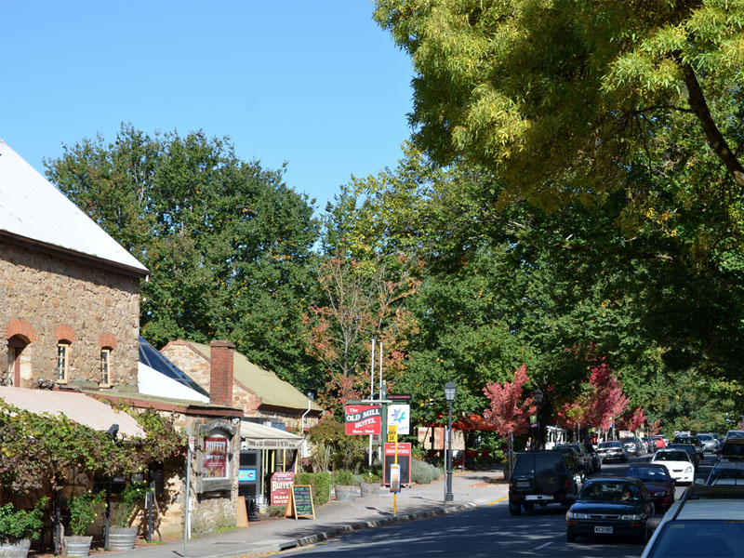
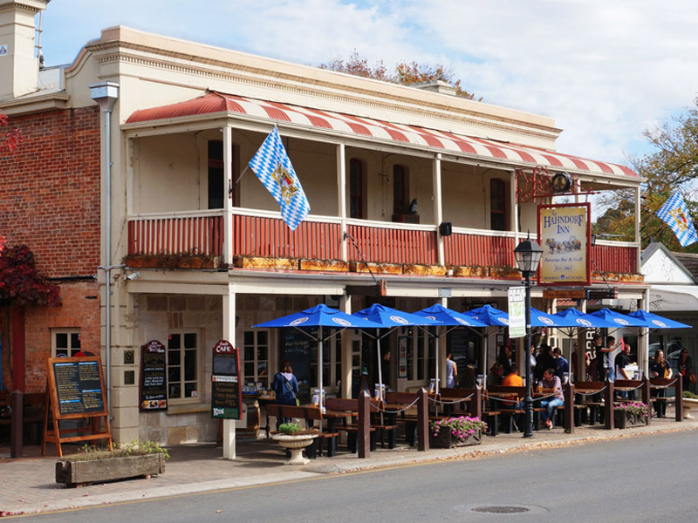
WIA AGM 2017
Hahndorf, South Australia (VK5)
  Adelaide Hills
  28km east Adelaide CBD
  Australia’s oldest surviving German settlement
  range of accomodation
  plethora of tourist options
Images courtesy of www.aussie towns.com.au

Slide 28
Questions
What does the WIA see as the role of local clubs in the future of amateur radio in Australia, and its relationship with them?

Slide 29

Response
Affiliated clubs should be one of the major vehicles for interfacing between the WIA & its members
The WIA needs to support clubs more
Two way street
  Clubs also need to support the WIA
Annual Clubs conference?

Slide 30
Questions
Has the WIA considered including an electronic version of the call book on the web site? I appreciate that some people will still want the hard copy and you may have a minimum order, but I think it would be a good way to gain members, just for the call book, even if it was a $10 opt in option or increase in fees?

Slide 31
Response
Technically possible to have a PDF version as a download
Would need to consider the impact to sales of the print edition
At the current print callbook price, we need to sell a minimum quantity to break even.
Retaill $30.00 and WIA members $25.00
Increase in fees is never popular.

Slide 32
Questions
Downloading the weekly national news ties me to the computer. Can the WIA consider pod casting the WIA weekly national news (maybe even through an App) to make it more portable ?

Slide 33
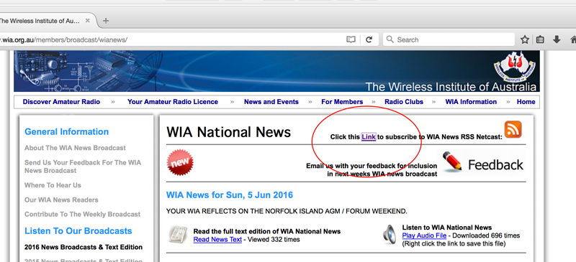
Response
Already available for people to subscribe
WIA website
  netcast
  The word podcast & the podcast logo – licenced/trademark

Slide 34
Questions
I have held an amateur radio licence since 1962 and a member of the SERG since its inception. As a member of the WIA I am concerned about the declining/low membership numbers. How best do you think the WIA and Amateur Radio Groups in Australia can best turn this situation around? I realise that the WIA can not do it alone, so members and clubs would need to participate.

Slide 35
RESPONSE
ACMA
  1988: 18,026
  1998: 16,197
  2014: 14,035
    4,465 WIA members (32 %)
  2015: 14,144
  RSGB/ARRL = 23%
  4% drop Christmas 2015
    Social media comments?
    Excludes repeaters, beacons and cancelled/expired licences.

Slide 36
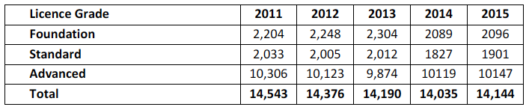

Slide 37
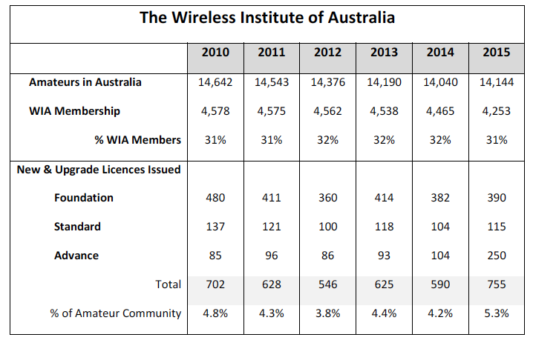

Slide 38
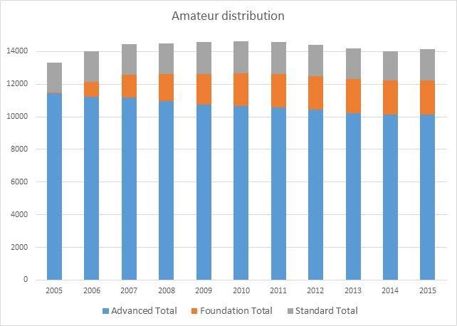

Slide 39
Turning it around
Think possitively
Promote the good things about the WIA
Encourage other club members to join & contribute
WIA membership largely depends on the total number of Australian radio amateurs
  Anything that increasess the number of hams will increase the WIA membership numbers
See the WIA for what it is
  Australia’s only advocacy channel for amateurs
  Small budget with 2 full time paid staff
Andy VK4NDY
  University of Southern Queensland
  Research project

Slide 40
Questions
What are your thoughts on the current debate on Social media with regards to the performance of the WIA?

Slide 41


Response
Facebook
WIA Reform Group
Debate is healthy
Constructive criticism
‘play the ball and not the man’.
Members service expectations increasing.
‘Too much to do and too much reliance on limited income and too much reliance on a few key personnel’

Slide 42
Questions
What steps are the WIA going to take to turn a trading loss into a trading profit?

Slide 43
Response
Rental of office space
Advertising
Review of AR magazine

