Slide 1
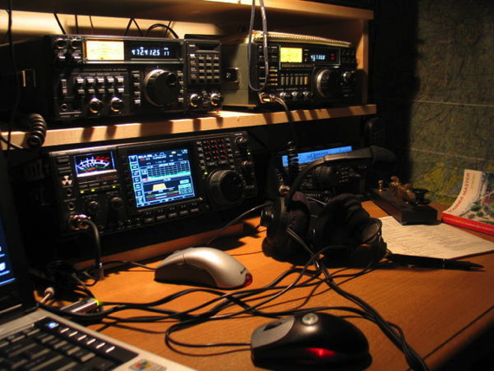
Amateur radio

Slide 2
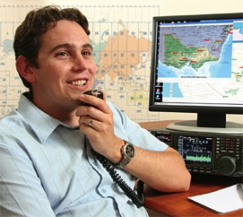
What is amateur radio ?
Multi faceted hobby
3 million people worldwide
Communicate – transmitting voice, Morse Code, digital modes, pictures, video signals.
Private recreation/non-commercial
ACMA
Notes:
Amateur radio is many different things to the individual three million plus people throughout the world who enjoy this multi-faceted communications hobby.
Amateurs communicate with each other by transmitting voice, Morse code, digital modes, pictures and even video signals.
It is a private recreational hobby and is non commercial.
In Australia, amateur licences are issued by the Australian Communications and Media Authority (ACMA)

Slide 3
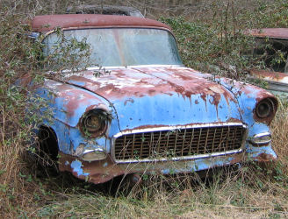
Is it similar to CB radio ?
Notes:
One of the most common responses when you tell somebody you're a radio amateur, is "is that like CB?". To which the answer is "yes and no".
Yes -- because they both involve two way communication.
But, to explain the "No", there are many more differences than similarities.
There are issues of more privileges for ham radio operators, e.g. more power, more bands.
Strict licencing.
Ham radio is also polite radio, without the crude and foul language of CB, probably due in large part to its licensing requirements.

Slide 4
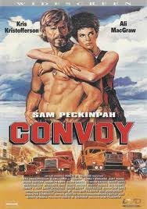
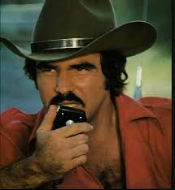
‘10-4 good buddy’
Formal
Q codes
NATO phonetic alphabet
Notes:
The Q code is a standardized collection of three-letter message encodings, also known as a brevity code, all of which start with the letter ‘Q’.
Initialy developed for commercial Morse Code communication, and later adopted by other radio services, especially amateur radio.
Burt Reynolds – Smoky and the Bandit
Convoy, with Kris Kristofferson

Slide 5
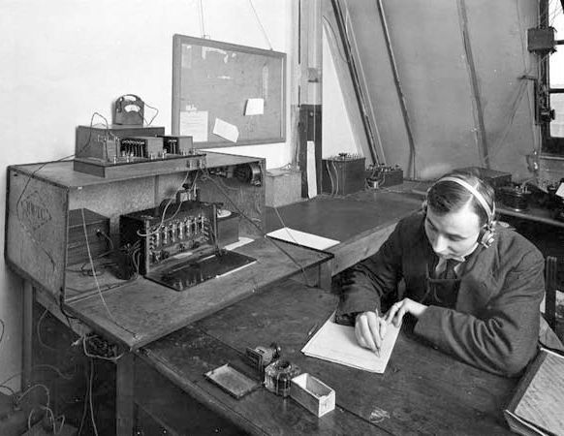
Popular image of amateur radio
Notes:
The image of Amateur radio has long since transcended the ‘older’ bearded individual who sits in a room filled with big black boxes full of glass tubes glowing in the dark while talking to people in a strange language.
The sound of strange beeps from a brass key used to complete this picture.
While this can still be seen, a brave new world of Amateur Radio has now emerged.
Today’s Amateur Radio is a world of modern communication and experimentation and in Australia has had a new lease of life since the regulations were changed in 2005 to remove Morse code and create the new “Foundation License”.
Since then, the hobby has been rejuvenated and has been taken up by many young people, including children and others who in the past would never have been able to participate.

Slide 6
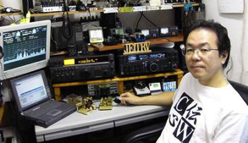
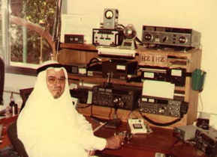
Demographics.
1,296,000 – Japan (1 % of the population)
739,000 – USA
75,300 - Germany
59,000 - UK
15,330 – Australia
6,000 – South Africa
Notes:
About 3,000 million amateurs around the world

Slide 7
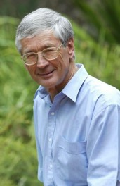
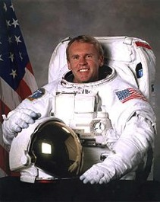
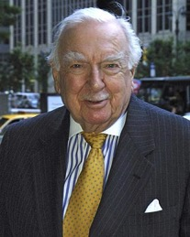
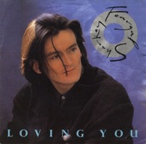
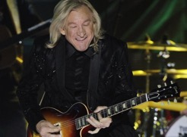
Famous amateurs
Dick Smith
Andy Thomas
Walter Cronkite
Joe Walsh
Feargal Sharkey
Notes:
There have been many ‘famous’ amateur radio operators over the years.
Dick Smith – Australian entrepreneur, businessman, aviator.
Joe Walsh – the band The Eagles
Feargal Sharkey – Irish singer from the 1980’s
Andy Thomas
Walter Kronkite – American broadcast journalist (now passed away).
Former King Hussein of Jordan
Yuri Gagarin – Russian cosmonaut
King of Morrocco and the King of Thailand

Slide 9
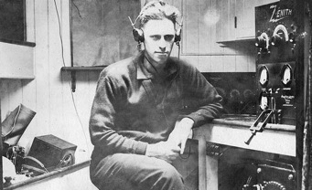
How did the term ‘Ham radio’ originate ?
In 1908 three Harvard Wireless members – Albert Hyman, Bob Almy, & Peggie Murray, created the acronym from their last names
Hertz, Armstrong, & Marconi
Amateurs in the early days causing interference
Notes:
There are various theories as to how the term ‘Ham’ came about. But no-one is really sure of the true origins of the term.
They include…..
1. In 1908 three operators from the USA created the acronym from their last names
2. It is sometimes claimed that HAM came from the first letter from the last names of three radio pioneers: Heinrich Rudolf Hertz, Edwin Armstrong, and Guglielmo Marconi. However this cannot be the source of the term as Armstrong was un unknown college student when the term first appeared at the turn of the 1900’s.
3. The term "ham operator" was commonly applied by 19th century landline telegraphers to an operator with poor skills. ‘Ham’ was also in more general use as a slang word, meaning ‘incompetent’.In the very early days of amateur radio, two amateurs, working each other across town, could effectively jam all the other operations in the area. Frustrated commercial operators would refer to the ham radio interference by calling them "hams." Amateurs, possibly unfamiliar with the real meaning of the term, picked it up and applied it to themselves.

Slide 10
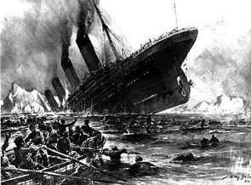
History of amateur radio
1886…..Heinrich Hertz proved the existence of radio waves
1899….. Guglielmo Marconi sends a wireless message across the English Channel.
1901….. Marconi communicated across the Atlantic
1910…..first ? radio society formed - Wireless Institute of Australia (WIA)
Notes:
The birth of amateur radio in general is mostly associated with various amateur experimenters.

Slide 11
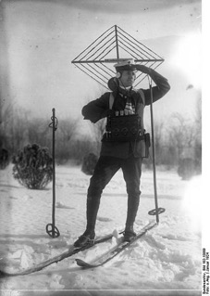
History of amateur radio
1911…..27 experimental licences in Australia
1912…..Titanic
1917…..World War One
1919…..Amateur service restarted
1920…..Numerical prefixes for each State of Australia
1923…..1st contact between UK & USA.
1938…..amateur radio ceases in Australia – WW2
Notes:
1911 - 27 experimental licences in existence in Australia. NSW - 22, Vic, 3, SA - 1, Tas - 1.
1912 – Following the sinking of the Titanic, the US Govt passed the Radio Act of 1912. This marked the beginning of US Federal licencing of amateurs
1917 – World War One puts a stop to amateur radio
1919 – the amateur radio service recommenced.
1920 - Numerical prefixes allocated for each state
1923 - the first two way contact between the UK and USA was in December 1923, between London and Connecticut.
1938 - 3rd September, Robert Menzies informed all Australian amateurs by telegram that amateur radio in Australia had officially ceased to exist. Amateurs were directed to go QRT and dismantle all equipment, and to notify the Senior radio Inspector when this order had been carried out.

Slide 12
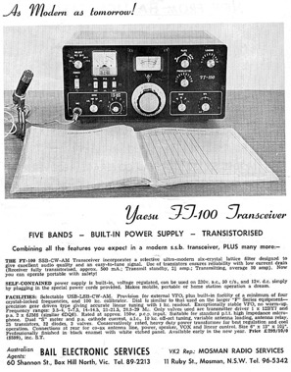
History of amateur radio
1945…..amateur activity resumes.
1947 - VK5KL (South Australia) has a 2-way contact with W7ACS/KH6 in Hawaii, a distance of about 9000km.
1975 – Novice licence introduced
2004…..Morse code removed
2005…..Advances & Standard licence
2006…..Foundation licence
2013…..North Korea
Notes:
1945 – end of WW2 hostilities, amateur radio recommenced.
1947, South Australian operator VK5Kl made contact with a station in Hawaii, a distance of about 9,000 kms.
1975 – Novice licenece was introduced (introductory licence)
2004 – The Australian Communications & Media Authority (ACMA) removes Morse as a requirement for amateur licences
2005 - The ACMA creates two licence classes, Advanced and Standard.
2006 - The ACMA adds the Foundation licence to the list of available classes. Amateurs with these licences have callsigns with the prefix VK#F, eg VK4F
2013 – North Korea is now the only country in the world which does not allow amateur operation

Slide 13
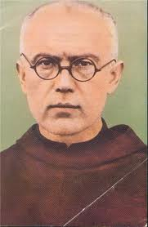
Fr. Maximillian Kolbe
Notes:
During the German occupation of Poland, the priest, Fr. Maximillian Kolbe,SP3RN was arrested by the Germans. They believed his amateur radio activities were somehow involved in espionage. He was transferred to the Nazi death camp Auschwitz on May 28, 1941. After some prisoners escaped inin 1941, the Germans ordered that 10 prisoners be killed in retributio. Fr. Kolbe was martyred when he volunteered to take the place of one of the condemned men. He was given a lethal injection of carbolic acid. On Oct 10, 1982, he was canonized by Pope John Paul II as Saint Maximillian Kolbe, Apostle of Consecration to Mary and declared a Martyr of charity. He is considered the Patron saint of Amateur radio operators.

Slide 14
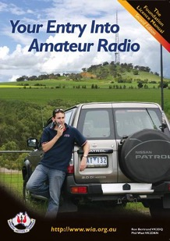
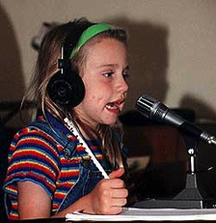
Getting a licence in Australia
Restructured in 2006.
Three levels
Foundation.
2 day course
Basic electronics
Practical
Standard.
Advanced.
Morse Code
no longer compulsory
Notes:
The licencing system in Australia was remodelled in 2006.
There are now three levels of licence in Australia: Foundation, Standard, Advanced.
Morse Code (or CW) is no longer a compulsory component.
The new Foundation Licence has provided the opportunity for people from all walks of life technical and non-technical to join in the hobby.

Slide 15
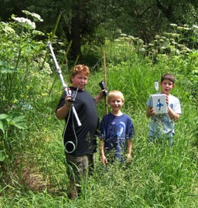
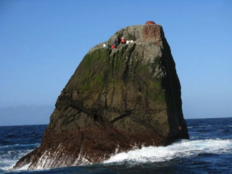
What can you do ?
Work DX (overseas)
Amateur radio satellites
Contests
Slow Scan Television (image mode)
Fox hunting
Remote Island Operations (IOTA)
Digital modes
Summits on the Air (SOTA)
Portable operation
Notes:
DX – telegraphic short hand for ‘distance’ or ‘distant’.
Satellites - There are several small satellites orbiting the earth. These satellites permit communications by morse code, voice, or packet radio, over large distances using line-of-sight frequencies in the VHF and UHF spectrum.
Contests
SSTV – amateurs swap colour pictures to each other around the world. The pictures are not moving, but rather a series of stills - like a slide show.
Fox hunting - Also known as hidden transmitter hunts, fox hunting tests the skills of its participants by requiring the competitors to locate a hidden transmitter in some defined area. Using directional antennas and other direction-finding equipment, you can find the direction the transmitted signal is coming from.
Islands on the Air
Digital modes – mention John VK5BJE
Summits on the Air
Portable operation

Slide 16
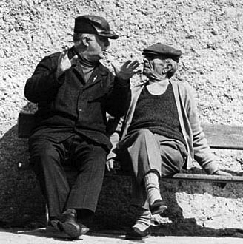
What do you talk about ?

Slide 17
International friendship
Notes:
Talk about Marnix, OP7M in Belgium
Travelling overseas

Slide 18
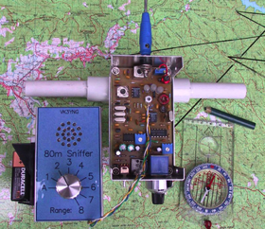
Hidden Transmitter Hunts
‘Fox Hunting’
Direction finding
Locating a small hidden transmitter
Directional beam antenna
Special receive ‘sniffer’
Notes:
Radio amateurs use DF when they take part in a popular activity called Foxhunting. This involves locating within a time limit a small hidden transmitter.
Foxhunting basically uses a directional beam antenna, both vehicle mounted or out-the-window, and receiver to DF the general hiding spot of the Fox. Then most Hounds use a special receiver called a "Sniffer" with variably sensitivity, to virtually sniff out the Fox. Numerous cunning tricks are played by those hiding a Fox as they seek to elude the Hounds. Regular Foxhunting Championship series are held all over Australia during the Foxhunting season.

Slide 19
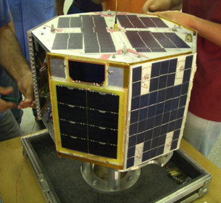
Satellites
Orbiting Spacecraft Carrying Amateur Radio (OSCAR)
Signal to satellite & relayed back to earth
Increased range of communication
Notes:
Soon after the launch by the former Soviet Union of Sputnik 1, the world's first man-made orbiting satellite, radio amateurs entered the space age with the OSCAR (Orbiting Spacecraft Carrying Amateur Radio) series of satellites.
International contacts are possible by sending a signal to a satellite and having it relayed back to earth providing communications over many thousands of kilometres.
Amateur Radio Satellites allow the amateur operator to greatly increase the range of communication through the amateur station.

Slide 20
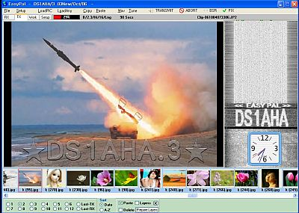
Sending pictures via Radio
Slow scan TV
software
Notes:
There are similarities between Fax and Slow Scan TV in that to transmitting a photograph or map is often spread over several minutes using coded low frequency tones and this process produces a signal that can be readily transmitted by HF radio.as well as by VHF or UHF. Both Facsimile and SSTV can transmit signals in colour, usually by the use of multiple scanning of each line using the three primary colours of Red, Green and Blue. The majority of amateur stations operating in Fax or SSTV modes use the power of the computer to generate the required tones and to to decode them back to pictures which can be displayed on the computer screen or printed.
There are a number of software programs allowing the amateur to operate in the Fax/SSTV modes.

Slide 21
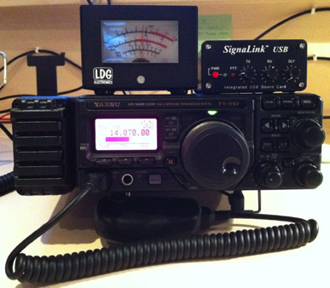
Digital modes
PSK 31 & PSK 63
Real time keyboard to keyboard contacts
Computer based
Sound card
Notes:
Increasingly popular modes are PSK31 & PSK63
They are real time keyboard to keyboard QSO’s.
PSK refers to Phase Shift Keying modulation used in the system.
PSK is computer based with sound card s well as the transceiver system to transmit and receive signals

Slide 22
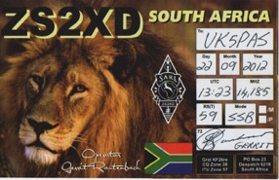
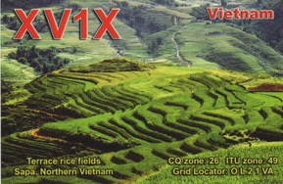
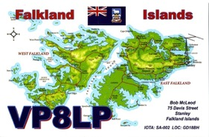
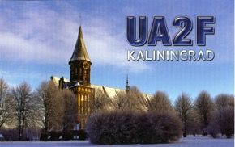
QSL cards
Written confirmation of a 2 way communication between 2 amateur radio stations.

Slide 24
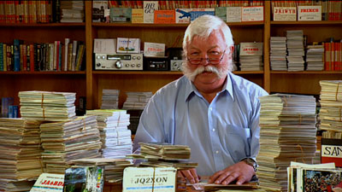
Notes:
Martin Luther, VK7GN
Appeared on the ABC TV show ‘The Collectors’ in July, 2011.

Slide 25
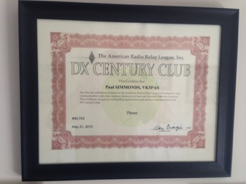
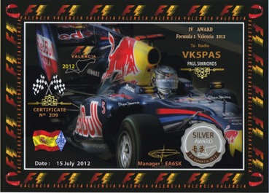
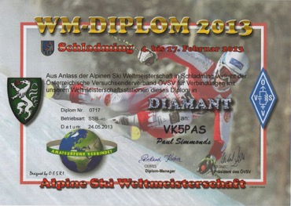
Awards
Notes:
Awards, usually in the form of certificates, are offered by the WIA and by many Australian radio clubs, to amateurs who have made contact with a given number of stations in a certain geographical region (for example, a state or continent).
The best known and most respected award is probably the DX Century Club award, or DXCC. This recognises the achievement of contacting stations in one hundred different countries.

Slide 26
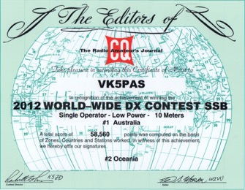
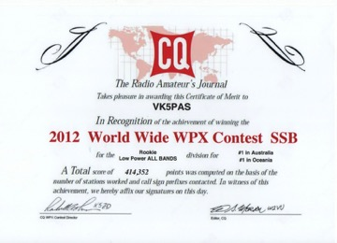
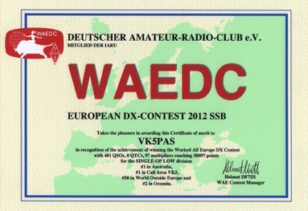
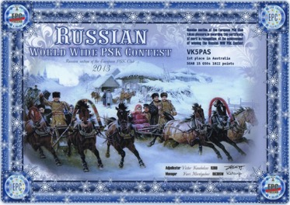
Contests
Notes:
Contesting is a popular activity amongst many radio amateurs. Various contests are held throughout the year, with the aim of promoting communications using a particular mode or band, or with a specific group of amateurs. The usual aim of a contest is to make contact with as many stations as possible, in the allocated time. Some contests attract thousands of hams from all over the world, all trying to log brief contacts with each other.

Slide 27
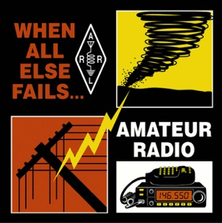
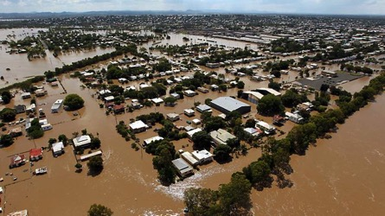
In times of emergency….. “when all else fails”.
Crisis & natural disasters.
Other forms of communication fail.
Valueable resource
Notes:
In times of crisis and natural disasters, amateur radio is often used as a means of emergency communication when landline phone, mobile phones and other conventional means of communications fail.
Unlike commercial systems, Amateur radio is dispersed throughout the community and is not dependent on terrestrial facilities that can fail or be overloaded, such as mobile phone base sites or satellite communications links.
Radio Amateurs worldwide provide a valuable resource to Emergency Services and Aid Organisations in times of need, either by providing the extra manpower required to cope with extended operations at emergency communications centres, or by providing facilities in the field (equipment and infrastructure including amateur VHF and UHF repeater systems etc.) when all else fails.

Slide 28
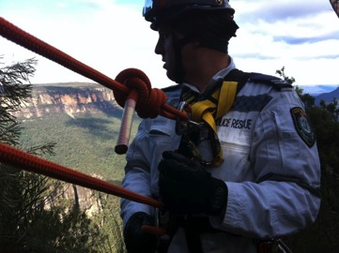
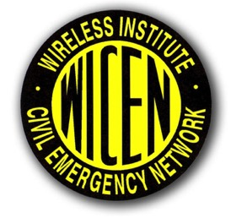
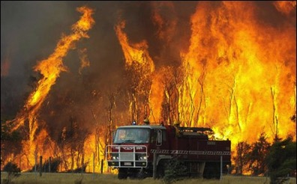
Notes:
It is a tradition in Australia for radio amateurs to provide communications for the benefit of the community. Emergency communications using Amateur Radio first occurred during the 1939 Black Friday bushfire disaster. Other major occasions include Cyclone Tracy 1974, Ash Wednesday bushfires 1983, the Newcastle Earthquake 1989, and the Black Saturday disaster in February 2009 in the State of Victoria with its more than 30 bushfires claiming 173 lives and destroying more 2,000 homes wiping out entire towns. More recently radio amateur repeater facilities were used for emergency service communications during the Queensland floods in January 2011
A few weeks ago radio amateurs planned a pivotal role in the search for a missing man in the Blue Mountains in NSW.

Slide 29
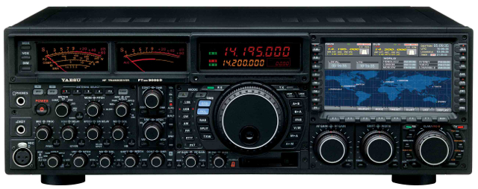
Equipment
Notes:
There is a wide range of equipment.
How big is your budget ?

Slide 30
Notes:
A little compact low power transceiver (can be built as a kit)

Slide 31
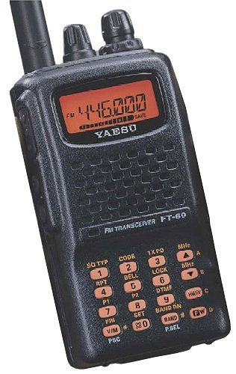

Slide 32
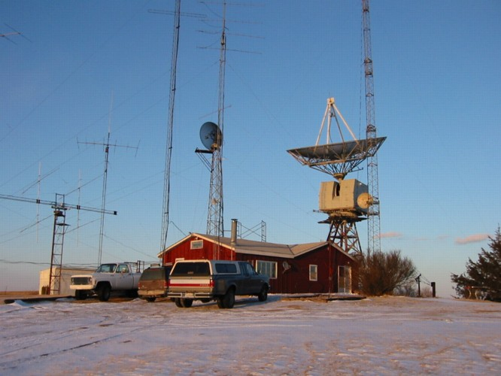

Slide 33
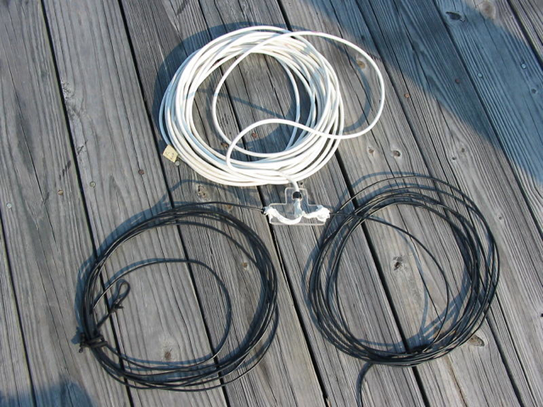
Notes:
A simple wire dipole.
Cost about $40.00
Or very easy to build.

Slide 34
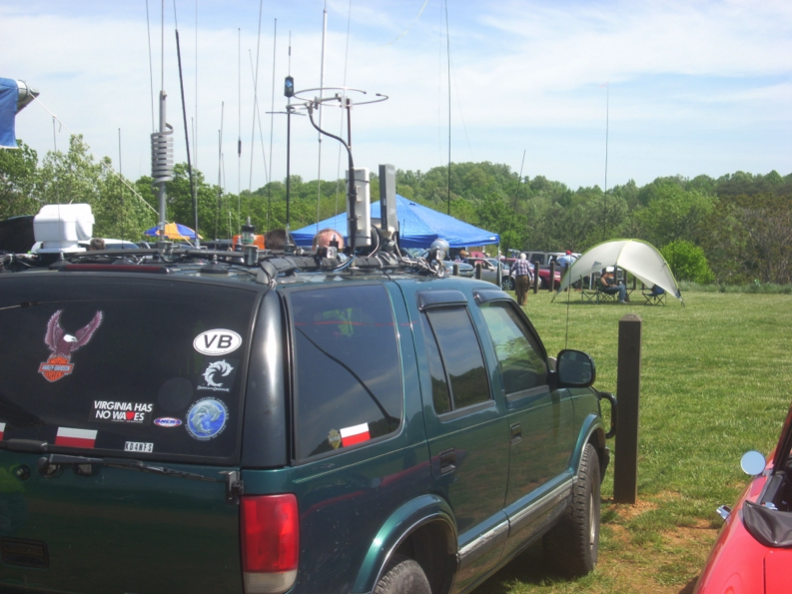

Slide 35
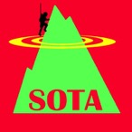
Summits on the Air (SOTA)
International Award program
Commenced in the UK in 2002
Encourages portable operation in mountainous areas.
Associations
Defined summits
Victoria, South Australia, ACT
Prominence (150m)
Activators
Chasers
Honour rolls
You don’t have to be a mountaineer
www.sota.org.uk

Slide 36
Summits on the Air (SOTA)
UK, Ireland, Germany, Austria, Greece, Hungary, Switzerland, South Africa, France, Belgium, Czech republic, Finland, Poland, USA, Liechstenstein, Norway, Sweden, Slovenia, Netherlands, Lebanon, Corsica, Macedonia, Canada, Falkland Islands, Luxembourg, Denmark, Malta, Romania, Bosnia, Ukraine, South Korea, Spain, Sardinia, Italy, Portugal, Slovakia, Estonia, Australia

Slide 37
Summits on the Air
“Shack Sloth”

Slide 38
Summits on the Air (SOTA)
“Mountain Goat”

Slide 40
Notes:
Mike, 2E0YYY
My first ever SOTA contact

Slide 41
Notes:
Steve WG0AT. Goats – Peanut & Rooster
Many videos on You Tube of his activations

Slide 42
Notes:
Operating from the top of Mount Ngadjuri in the mid north

Slide 43
Notes:
Operating from Brown Hill Range in the mid north

Slide 44
Notes:
Operating from Mount Bryan

Slide 45
Notes:
Allen, VK3HRA

Slide 46
VK5 National & Conservation Parks Award
Adelaide Hills Amateur Radio Society
Encourages portable operation from SA’s 21 National Parks & 262 Conservation Parks.
Running since April 14th 2013
Over 50 different parks activated
www.ahars.com.au
www.paulsimmonds.weebly.com
Notes:
Andy, VK5LA

Slide 47
Notes:
John, VK5BJE in the Ramco Point CP

Slide 48
Notes:
Kim, VK5FJ, in the Coorong National Park.
David, VK5KC in the Redbank Conservation Park
Andy, VK5AKH in the Sandy Creek CP

Slide 49
Portable equipment
Radio…..1.17 kgs.
Antenna…..390 grams.
Telescopic Squid pole.

Slide 50
Portable equipment
Notes:
Lipo batteries
Sealed lead acid batteries

Slide 51
Notes:
Pete, G6UOI (now a silent key)
Pedestrian mobile

Slide 52
Notes:
Dave, G4AKC

Slide 53
Notes:
Peter, VK3YE
Pedestrian mobile on the beaches in Melbourne

Slide 54
Notes:
Marshall, VK3MRG

Slide 55
More information
http://www.wia.org.au

Slide 56
Any questions ???
http://www.ahars.com.au

