Slide 1
Summits on The Air
Taking Amateur Radio to New Heights!
A Crash Course In Chasing And Activating Summits
By
Pat Harris – KI4SVM And Pete Larson – WH6LE
W4C/CM-081 Cedar Rock Mtn
Notes:
Good Evening. I would like to thank Paul and Mitch for inviting us to talk about Summits on the Air with your club. Both Pete- WH6LE and myself are very active participants in the program. I have found SOTA to be a whole lot of fun and very rewarding. What can be better than combining a couple of great hobbies – hiking and ham radio. Our goal tonight is to give you a nuts and bolts tour of SOTA, so that you have the information you need to jump right in, either chasing and/or activating a summit.

Slide 2
What is Summits on the Air?
“For as long as there has been radio, amateurs have taken their stations to the tops of hills… It’s perhaps a little surprising then that no formal programme for activating summits existed until March 2002!”
Radcom , July 2004
Awards program for hams and SWLs, that encourages portable operation in mountainous areas.
There are awards for Activators (those operating portable from mountaintops) and Chasers (those operating from home, portable or even another summit).
Notes:
This quote is from the early days of SOTA, long before it made it’s way to North America, but I still like it. There is some basic connection between hams and operating portable. When someone finds out that you are out operating portable, especially mountain topping, they always want to know more - your setup, your location, your weather, your hike.
All internet based
Database driven
Volunteer run
Awards and certificates are done at cost.
S2S
But there are other rewards as well. Spending a day in the woods is always fun, operating portable makes you a better operator and you will get to meet a lot of great hams.

Slide 3
The Basics
Summits - must have a prominence of 500’ and are assigned point values from 1-10 based on elevation.
Activators – Hike to summit, 1 QSO to activate, 4 QSOs to claim points, once per year for points.
Chasers – Contact an Activator, claim points, once daily per summit.
Chris – W4CCH on W4G/NG-048, Yonah Mountain
Notes:
Only certain mountain tops qualify for SOTA. The only requirement is that they have a prominence of 500’. Prominence is a geographical term relating to the elevation you have to descend to the saddle or gap between a mountain top and the next taller mountain. We could have a lengthy discussion about prominence but it doesn’t really matter. Any area where SOTA has been organized, all the hard work has been done for us already. Paul mentioned that Morrow Mountain is a popular local mountain topping location and unfortunately it doesn’t meet the prominence requirements. Not only that, Morrow Mtn is a very complicated example to explain prominence. It’s parent is 80 miles away north of Statesville.
Explain Associations and regions, Association Managers, ARMs
91 Associations in Western & Eastern Europe, UK, Scandinavia, Middle East, Africa, Australia, Asia and NA.
63K Summits
Activated Summits : 16729
SOTA Regions : 754
All summits are not accessible or legal.
Final access “person powered”
No Fossil fuels
Separate from vehicle
Activation zone
All modes and bands 160 to microwave to moonbounce
Drive up
AZ Shuffle
Seasonal bonus points
Zulu Time
No terrestrial repeater contacts
Number of Activators : 3359
12m Challenge/S2Ss
Multiple bands
Multiple Ops
Number Of Chasers : 3535
Chasers Who Are Also Activators: 2143

Slide 4
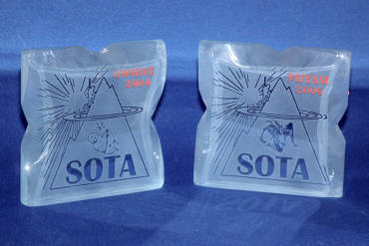
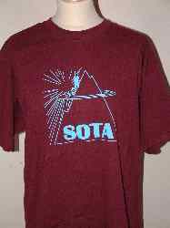
Awards and Stuff
W4G/NG-086, Currahee Mountain
Notes:
Lots of personal goals
First activation
Seeking unique summits
SOTA completes
My chaser completes

Slide 5
Getting Started
http://SOTAwatch.org is your One-Stop Shop for SOTA.
Link to Register/Login for SOTAwatch in upper-right.
Links to all important SOTA resources in main menu.
Short listing of active spots and upcoming activations.
Latest discussion topics in right-hand column.
Pete – WH6LE on W4C/EM-001, Grassy Ridge Bald
Notes:
Mention NA-SOTA Yahoo! group

Slide 6
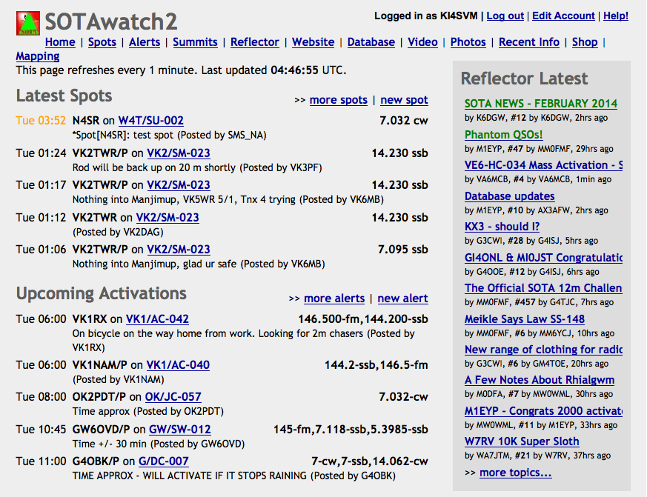

Slide 7
Chasing
Head on over to SOTAwatch to find activity
Tune to an activator’s spotted freq, listen for a CQ or QRZ and throw out your callsign.
Basic exchange is callsign and signal report.
If you are waiting on an alerted activation, keep in mind that you may have to tune up and down the band from the activator’s posted frequency.
Log your contact(s) into the SOTA database.
W4C/US-014, Laurel Fork Mountain
Notes:
The easiest way to get involved in SOTA is to start chasing. You can go home tonight and probably find active spots on SOTAwatch. Of course, they are probably from Australia at this time of night, but there is activity around the clock, seven days a week. I often get a chance to work a european activation or two, when I am getting ready to go to work in the mornings.
Keep in mind that an activator may be facing less than optimal conditions, weather, bugs, wildlife

Slide 8
Chasing Tools
SOTA Spot Monitor by KU6J (Windows) http://www.ku6j.com/
SOTA Goat by WW1X (iOS) http://ww1x.com/sotagoat/
Rucksack Radio Tool by DL1DLF (Android) http://www.dl1dlf.de/rucksack_radio_tool
SOTA Cluster by MM0MFM hostname:elgur.dyndns.org port:7300
Shack on a Tarp on W4C/CM-020 Green Knob, NC

Slide 9
Activation –Planning
Pick a Summit with the aid of
SOTA Mapping Project
Summit Lists
Explore Routes/Access
Summit Info Pages
SOTA Mapping Project Tracks database
Hiking guide books and maps
Google It!
Shack on W4G/NG-022, Black Mountain
Notes:
Legal Access
Not all summits are accessible

Slide 11
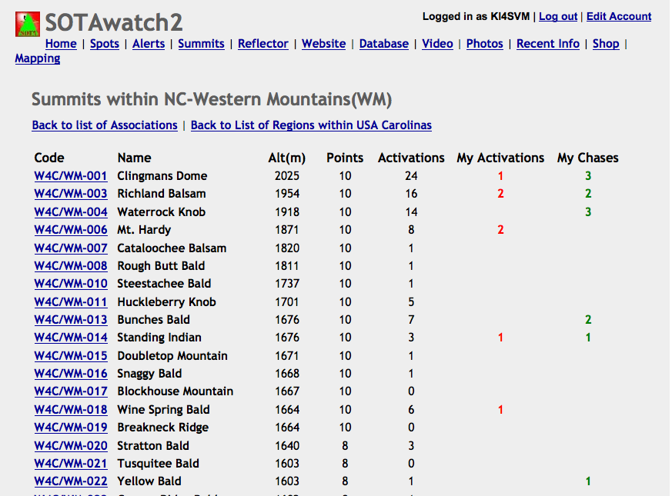

Slide 12
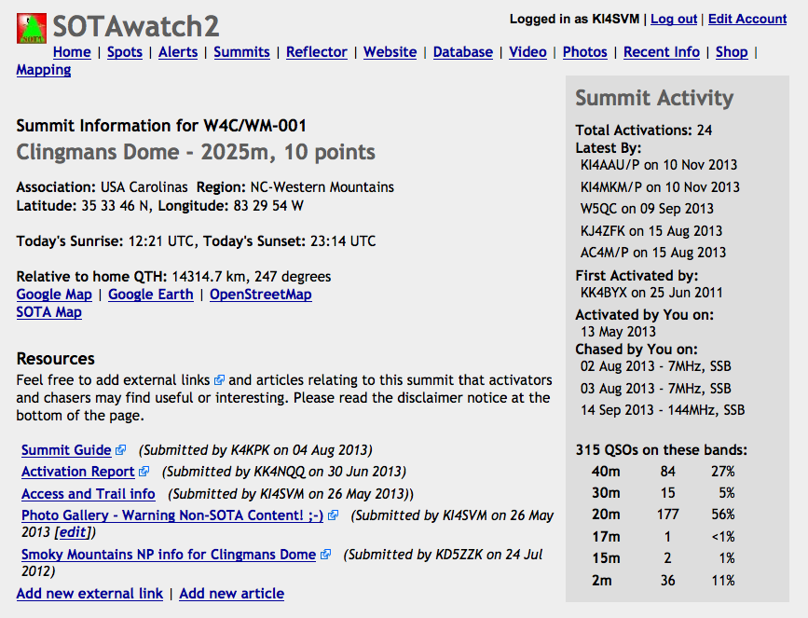

Slide 13
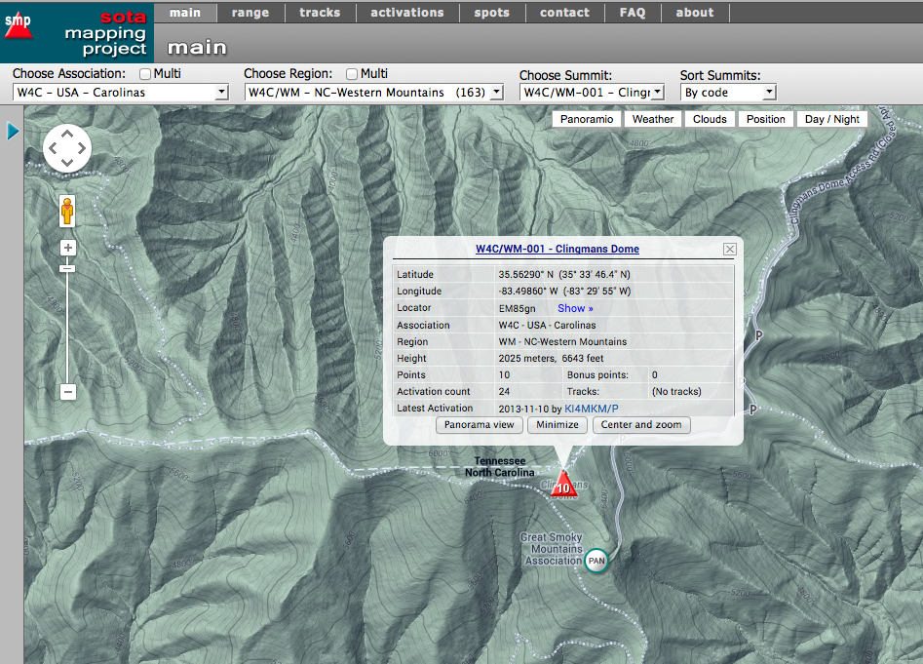

Slide 14
Activating – Equipment
Transceivers
HF Rigs - Yaesu 817, Elecraft KX3, Icom 7000, Yaesu 857, KD1JV’s ATS, PFR or MTR series, TenTec HB1B
VHF/UHF - HTs, Yaesu 817
Antennas
HF - EFHWs, Linked Dipoles, Doublets, Magnetic Loops
UHF/VHF – Aftermarket duckies, Arrow or Elk beams, ½ wave dipoles, J-poles, Tiger Tails
Deluxe Shack on W4C/WM-047, Toxaway Mountain

Slide 15
Activating – Equipment (cont.)
Power
Batteries - SLA, Li-ion, LiFePO4, NiMH
Solar Panels
Logging
Paper Logs
Digital – HamLog, SOTA Logger
Other
Tablet, Netbook, Smart phone or external device for digital modes
KD5ZZK – Andrew on W4G/NG-002, Rabun Bald

Slide 16
Activating – Prepping
Post an alert on SOTAwatch.org with your estimated time, frequencies and modes
Pack your backpack
Safety is Number One Priority
Comfort is Number Two Priority
Radio Gear is Number Three Priority
Make a checklist
Charge batteries and pack gear the night before
W1DMH – Doug on W4T/SU-035, Snowbird Mountain
Notes:
Practice setting up your gear at home.
Plan your itinerary working backwards, giving yourself a 30 min buffer on the summit.
First aid, flashlight, lighter, GPS, etc
Clothing, water, food, insect spray, sunscreen, TP
Organization of gear

Slide 17
Activating - Spotting
CW activators have the benefit of the RBNGate by KU6J which mines the RBN and autospots for them
SOTAwatch, www.sota.org.uk/Spotlite
Apps – SOTA Goat, Rucksack Radio Tool, DroidSpot
SMS – Text Message to SOTA gateway
APRS – APRS Message to SOTA gateway
Chasers – Esp. useful if all else fails
View from W4C/EM-005, Elk Knob

Slide 18
Activating – On the Air
Find a clear frequency and confirm it’s not in use
Take a deep breath and get ready for the fun
Self-spot if you can or just start calling CQ
Make sure you mention your callsign and summit reference every couple of QSOs
Pick out a callsign from the responders, exchange reports, log it, and call QRZ
W4G/NG-002, Rabun Bald
Notes:
Relax, have fun, you are in control

Slide 19
Activation – Wrap-up
Tear-down and have a safe hike out
Upload your logs to the SOTA database
Direct entry into database
Upload a CSV file
Manually created
Converted from an ADIF export from your logging software
Start planning your next activation!
KF4LXB – Christian on W4C/WP-010, The Pinnacle

Slide 20
Questions?
KI4SVM – Pat on W4G/NG-049, Pinnacle Knob

