Slide 1
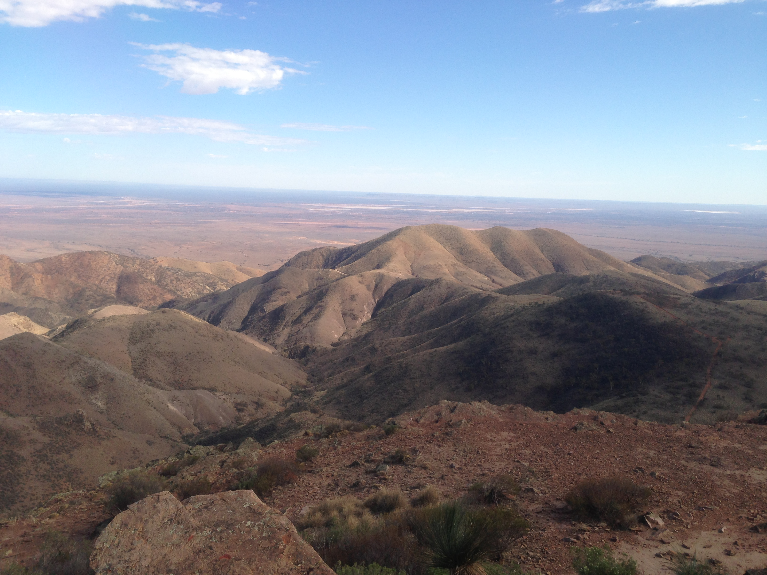
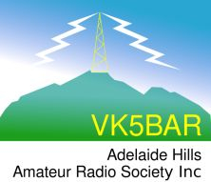
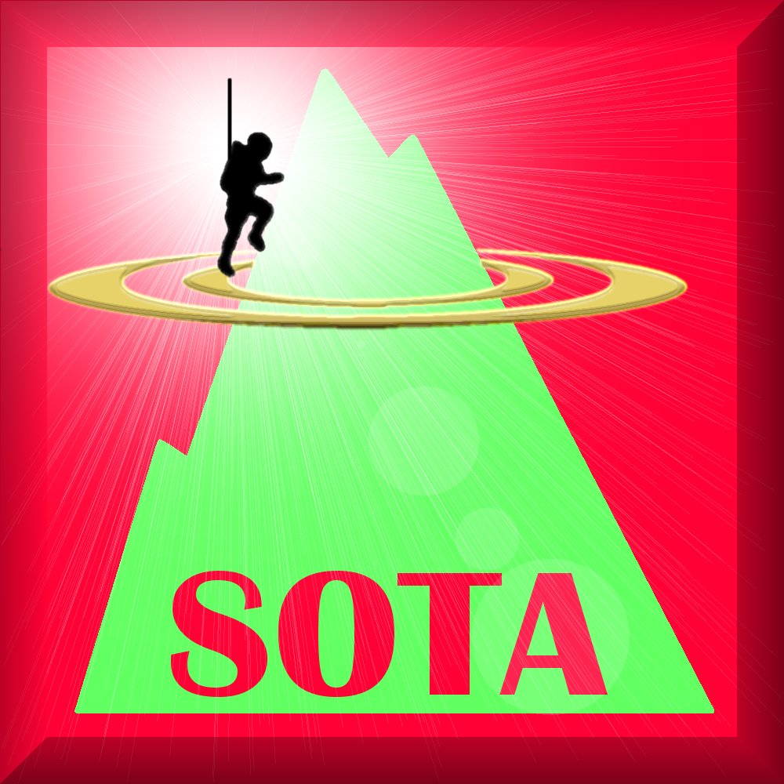
“Topographic prominence”
Presentation by
Paul VK5PAS

Slide 2
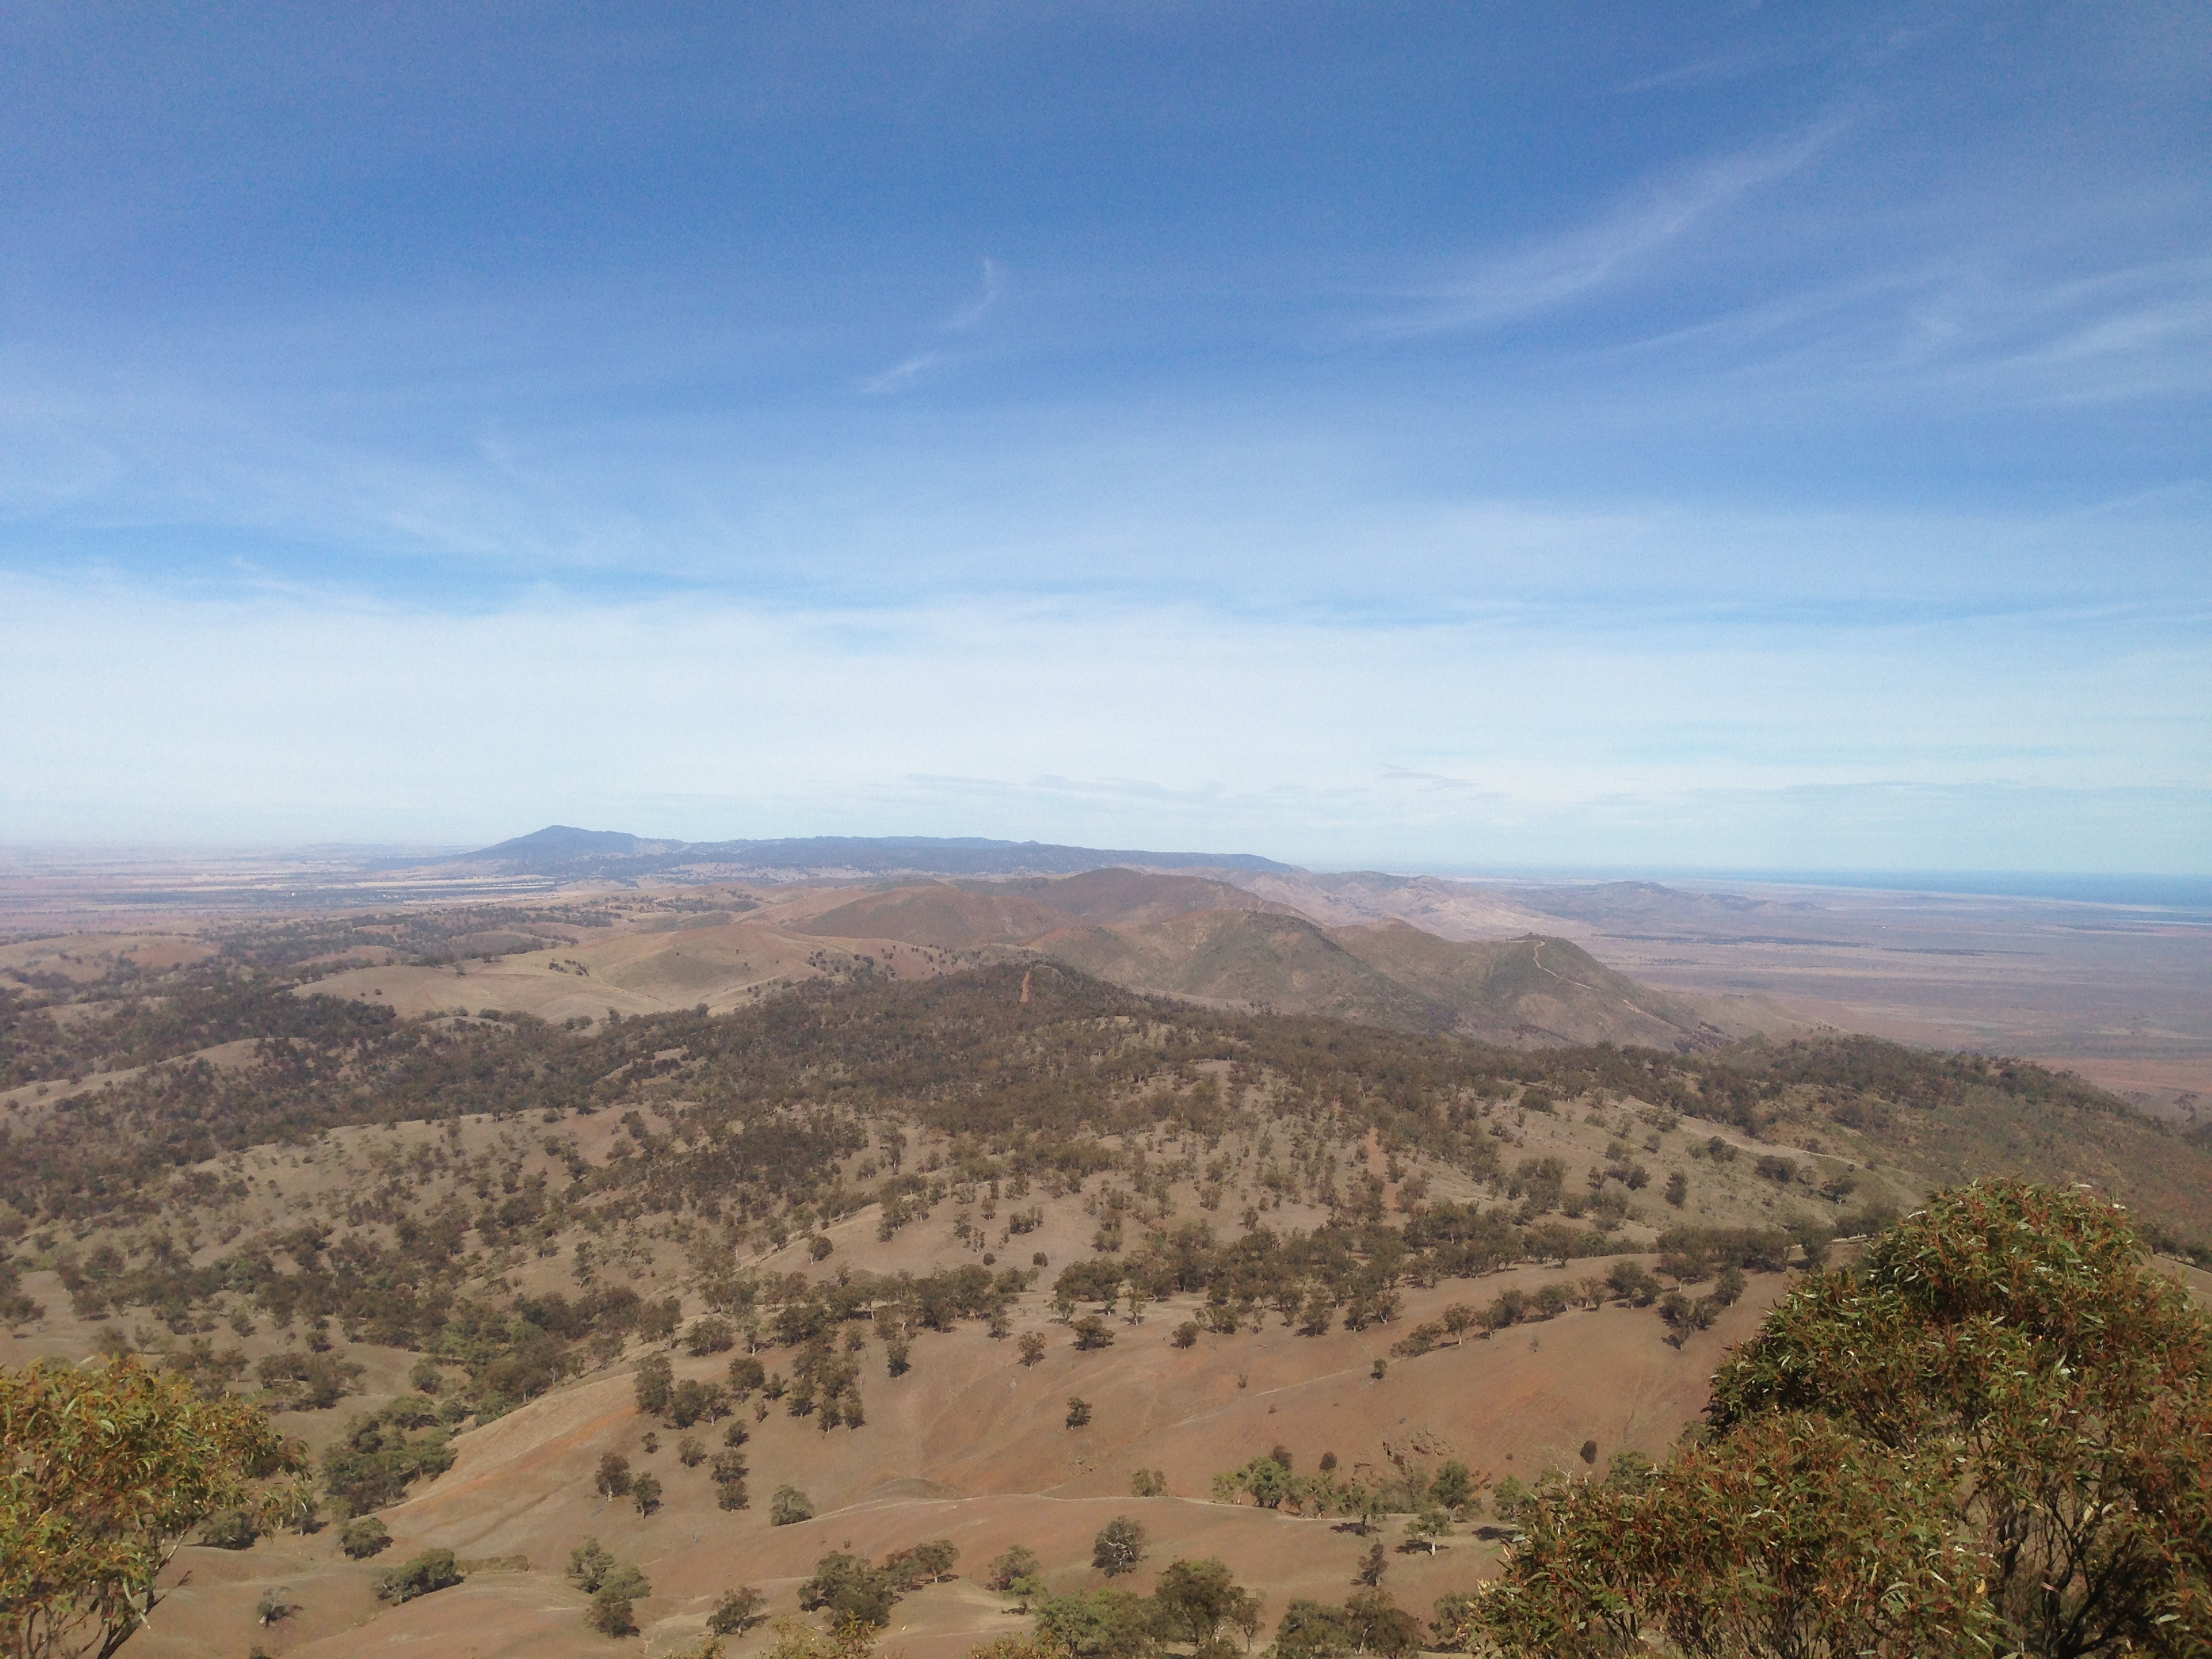
What is the relevance of topographic prominence to us as amateurs ???
SOTA

Slide 3
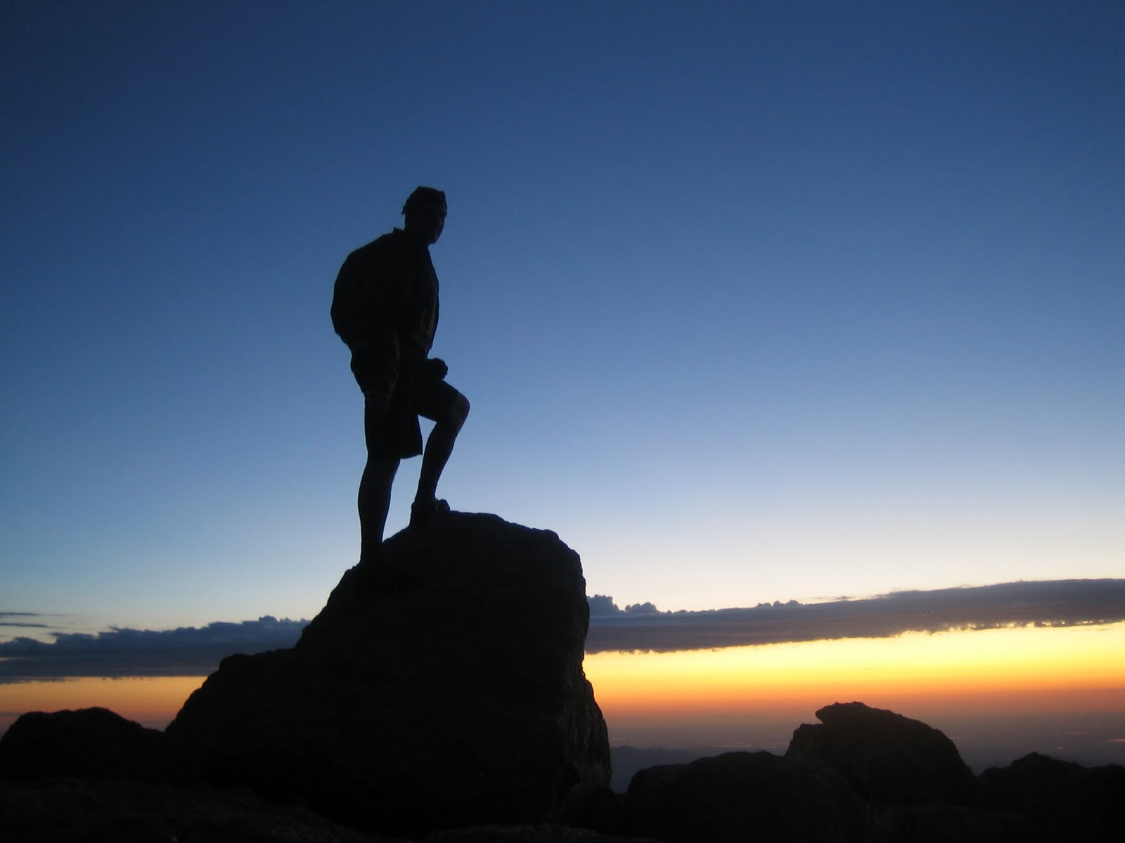
Topographic prominence
Summits of mountains have long been known by their elevation above mean sea level.
Growing community of climbers, mountain enthusiasts, & mathematicians
Summits can also be measured by their elevation relative to the surrounding terrain

Slide 4
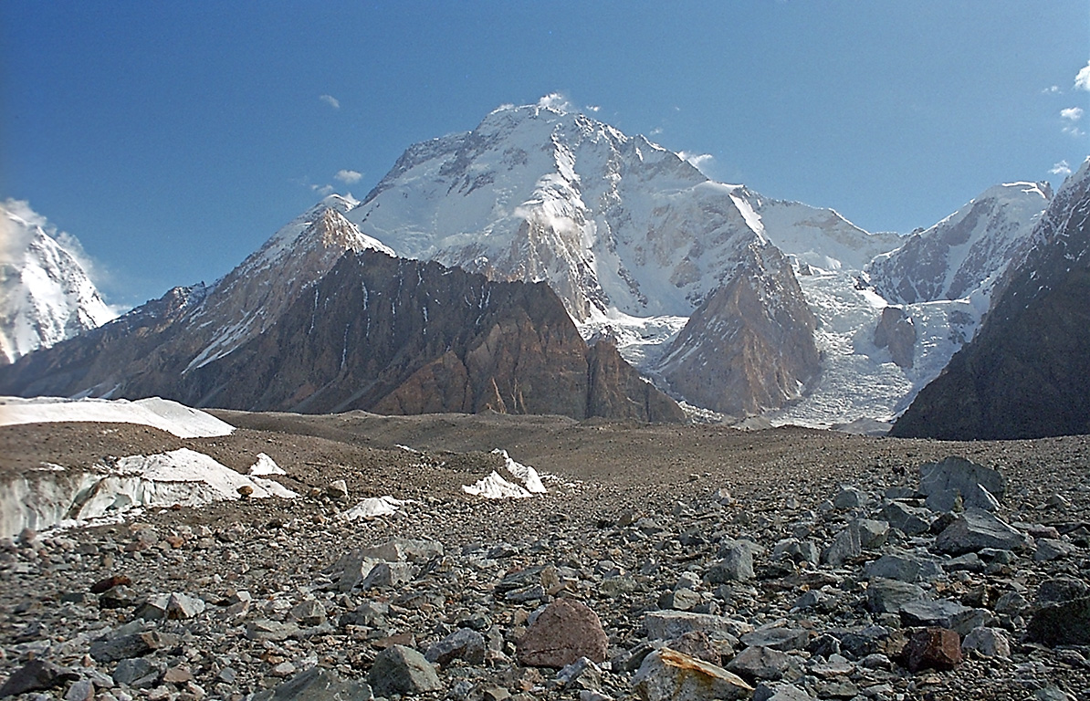
Prominence is defined as…..
vertical distance a given summit rises above the lowest col connecting it to a higher summit.
it is the elevation difference between the summit of a peak and the lowest contour that contains the given peak and no higher peaks.

Slide 5
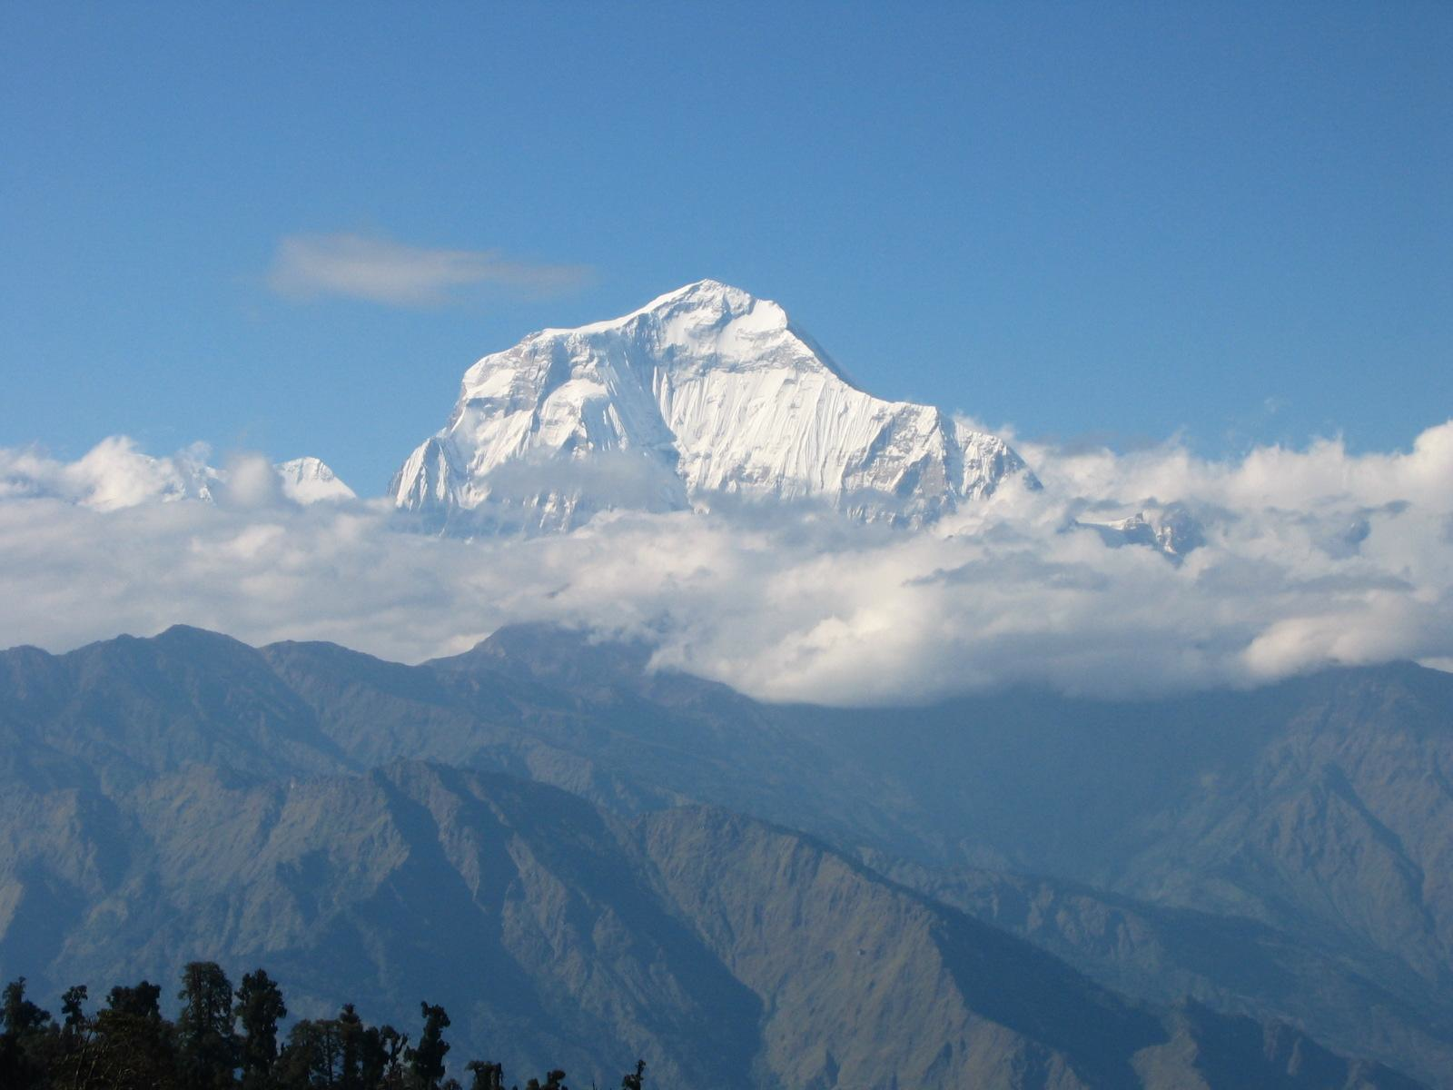
Prominence categorieses the height of the mountain or hill’s summit by the elevation between it and the lowest countour line encircling it and no higher summit
It is a measure of the independent stature of a summit
In essence, how much a mountain stands out from its surrounding terrain.

Slide 6
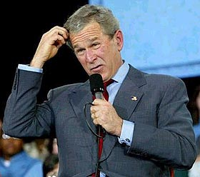
Different names for prominence…..
Relative height or prominence (SOTA)
Autonomous height
Shoulder drop (Nth America)
Prime factor (Europe)
Notes:
There is a definition of ‘relative height’ in the SOTA General Rules. It states:- ” ….This value, also sometimes referred to as Prominence…”
However in Section 3.5 it refers exclusively to ‘prominence’, and there is no reference to the term ‘relative height’ in this Section or any other part of the document.

Slide 7
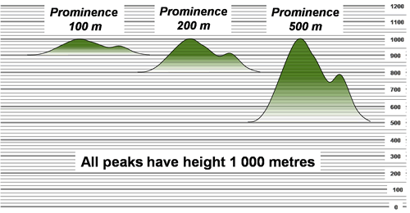
All 3 peaks have a height of 1,000 m ASL
Notes:
The summit on the left with prominence 100 m would be an interesting peak on a mountainous ridge but would be unlikely to be considered a significant mountain in its own right. The middle peak with prominence of 200 m would be generally considered a more interesting challenge. However, the peak on the right with a prominence of 500 m will be either a distinct peak or the dominant peak of a mountainous ridge.

Slide 8
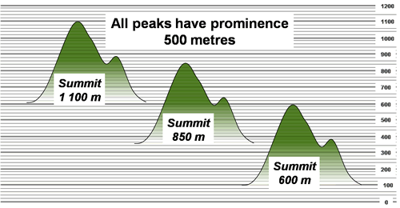
All peaks have prominence of 500 metres
Notes:
All three peaks in the illustration have a prominence of 500 metres, yet they have summit heights of 600, 850 and 1100 metres. The 600 m summit on the right would require the walker to start at close to sea level. The 850-metre summit is higher but if the walker started walking from a valley with elevation 350 metres, the challenge would be no greater than for the 600 metre summit. Similarly, if a walker starts to ascend the 1100 m summit on the left from a plateau at 600 m, the challenge is equal to that of the other peaks.

Slide 9
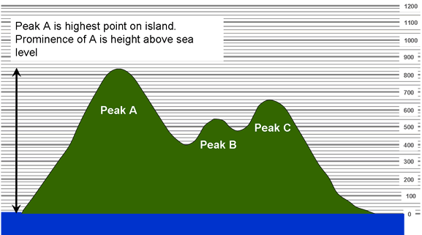
An island with 3 peaks
Peak A 840 m ASL
Peak B 550 m ASL
Peak C 660 m ASL
Notes:
Let’s imagine an island with 3 peaks:
- Peak A with summit at 840 metres above sea level
- Peak B with summit at 550 metres above sea level
- Peak C with summit at 660 metres above sea level.
Since Peak A is the highest on the island the lowest contour enclosing it is the shoreline of the island. Thus the prominence of A is equal to its elevation.
For Peak C the lowest contour that encircles it and no higher summit is the contour at the lowest point between Peak C and Peak A. This lowest point is known as the key col.

Slide 10
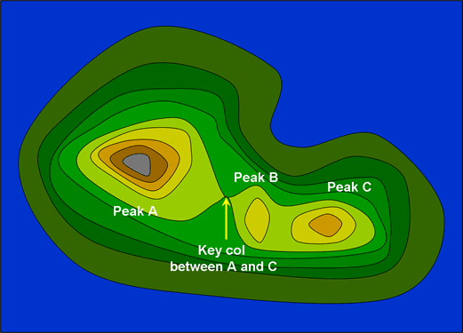
Key Col

Slide 11
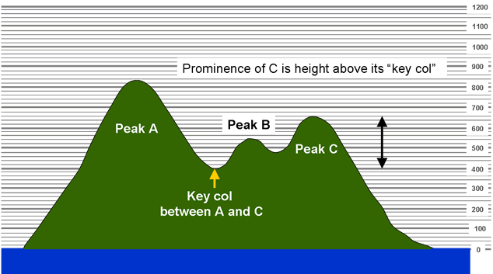
Prominence of Peak C
Is its elevation above its key col
Key col 400m
C’s prominence 660m - 400m = 260 m
Notes:
The prominence of Peak C is its elevation above its key col.
The key col has an elevation of 400 m so C’s prominence is (660-400) m = 260 m.

Slide 12
Flooded Island analogy
Notes:
Sometimes it is not easy to visualise contours surrounding a peak. An equivalent way to think of prominence is to imagine an island being flooded.

Slide 13
Flooded Island analogy
Notes:
The point at which the “flooding” separates the islands is of course the key col between A and C.
If the flooding were extended further to the point where peak B was just separated on a different island to C, then B’s prominence would be its height above that flood level. This is equivalent to the height above the key col between B and C.

Slide 14
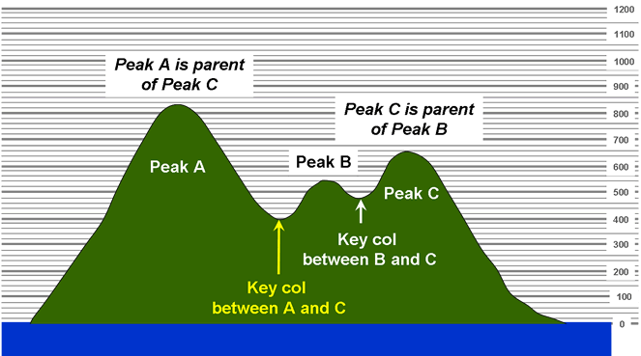
Hierachy of Ancestors and their Descendants

Slide 15
An example in Hawaii
Notes:
As mentioned above, conceptually, it is easiest to understand prominence if we imagine that we can raise and lower the sea level at will. At a certain elevation, any mountain range could be made to be its own sea-island. By extension, at a certain elevation, every summit would become the highest point of its own island.
Mauna Kea is the highest point on the island of Hawaii at an elevation of 13,796 feet. In order to ascend to a higher point while staying on the surface of the earth one would first have to descend to sea level, then re-ascend on another island or continent. Thus the summit of Mauna Kea has 13,796' of prominence, the height by which this summit protrudes above all other points on the earth's surface manifold. High points of islands and continents have elevations that equal their prominence.
Mauna Loa is the second highest summit on Hawaii. At 13,679' it is just 117' lower than Mauna Kea. Let's say that we could raise and lower the sea level at will. As the sea rose, the island of Hawaii would shrink in size until it was essentially dumbbell shaped: a pair of volcanoes. At 6,600' feet, the rising water would form a channel separating Mauna Loa from Mauna Kea at the low point of the ridge that connects the two volcanoes. At that moment Mauna Loa would be 7,079' above the new sea level; the mountain's prominence value.
Humuula is the Key Saddle for Mauna Loa.

Slide 16
SOTA Management Team recommends…..
Minimum ‘relative height’ or ‘prominence’ for summits to qualify for the SOTA program…..
150 metres
(equates to about 492 feet)

Slide 17
Why ?

Slide 18
SOTA, Section 3.5 (1)
“The Association must have sufficient topology to enable meaningful Summits to be defined. The SOTA Management Team recommends a minimum prominence for summits of 150m. The minimum association prominence that can be accepted in the Programme is 100 m. In the event that this rule cannot be met, the Entity or Subdivision will, unfortunately, be unable to participate in SOTA”.
Notes:
Topology is the mathematical study of shapes and spaces

Slide 19
SOTA rules……Section 3.5 (2)
"Summits should be distinct peaks. This means that there must be a vertical separation of at least the association's prominence value, between Summits and their associated cols (also known as saddles). Peaks separated by a shallow col should be considered as a single Summit. This principle ensures that there is a distinct climb associated with every Summit".

Slide 20
Qualifying summits
Notes:
Prominence between A and B is 200m
Prominence of C is 400m

Slide 21
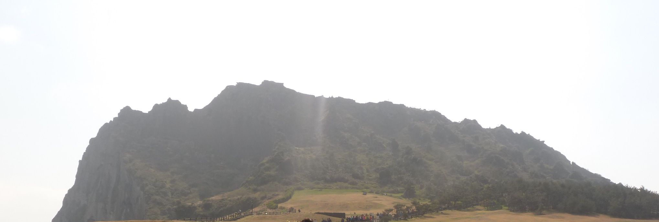
Example of shallow cols
According to SOTA this is one defined peak. Not separate peaks !
Notes:
An example of shallow cols. This according to SOTA is one defined peak. Not separate peaks.

Slide 22
The nuts & bolts of terminology…..

Slide 23
SOTA definition of ‘relative height’…..
"The height of a Summit relative to the surrounding countryside. This is not related to height ASL, except where the surrounding countryside includes coastal areas. This value, also referred to as Prominence, will never be less than 150m".

Slide 24
Prominence
The height of a summit above its highest col (called the key col) is effectively a measure of a mountain’s prominence, an important measure of the independence of its summit.

Slide 25
What is a Col ?
Geomorphological term
Geomorphology: is the scientific study of landforms and the processes that shape them
Refers to the lowest point on a mountain ridge between 2 peaks.
May also be called:
notch
gap
Saddle (usually has a wider meaning – may contain a mountain pass).

Slide 26
SOTA defintion of ‘Col’…..
“The lowest point along a ridge between two Summits (also known as a ‘saddle’)”

Slide 27
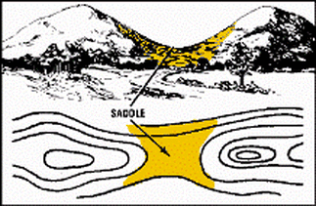

Slide 28
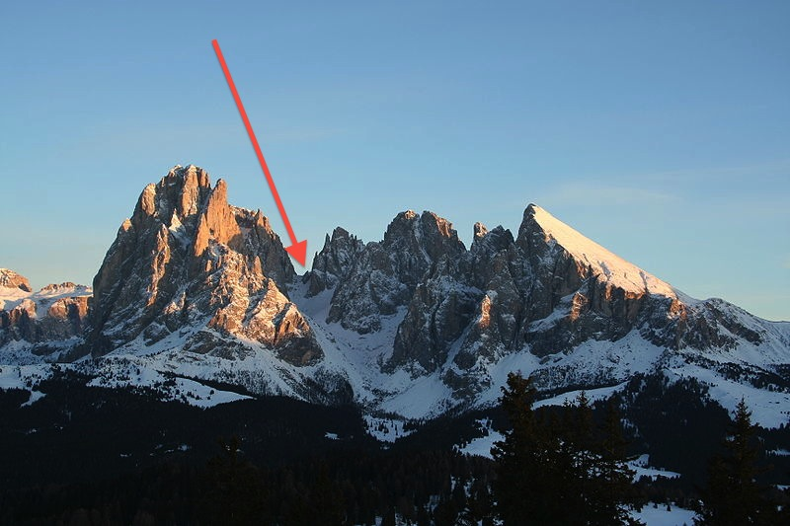
Clearly visible Langkofel col
Langkofel Group in Italy
Notes:
The Langkofel Group in Italy with the clearly visible Langkofel Col, left of centre

Slide 29
Mountain pass
A route through a mountain range or over a ridge.

Slide 30
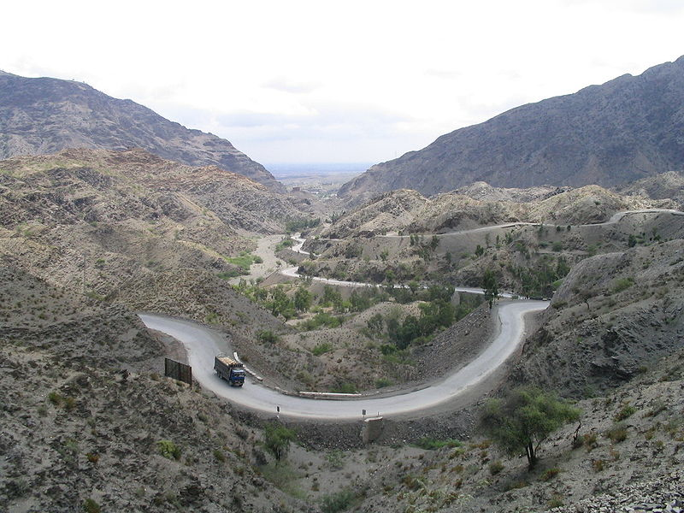
Notes:
The famous Khyber Pass in Pakistan

Slide 31
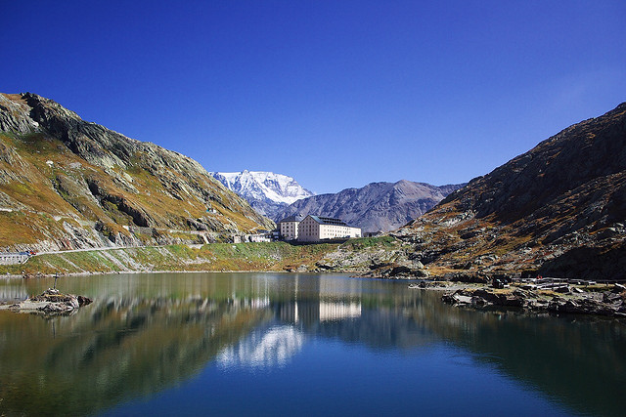
The Great St Bernard Pass in FRANCE
Notes:
The Great St Bernard Pass in FRANCE

Slide 32
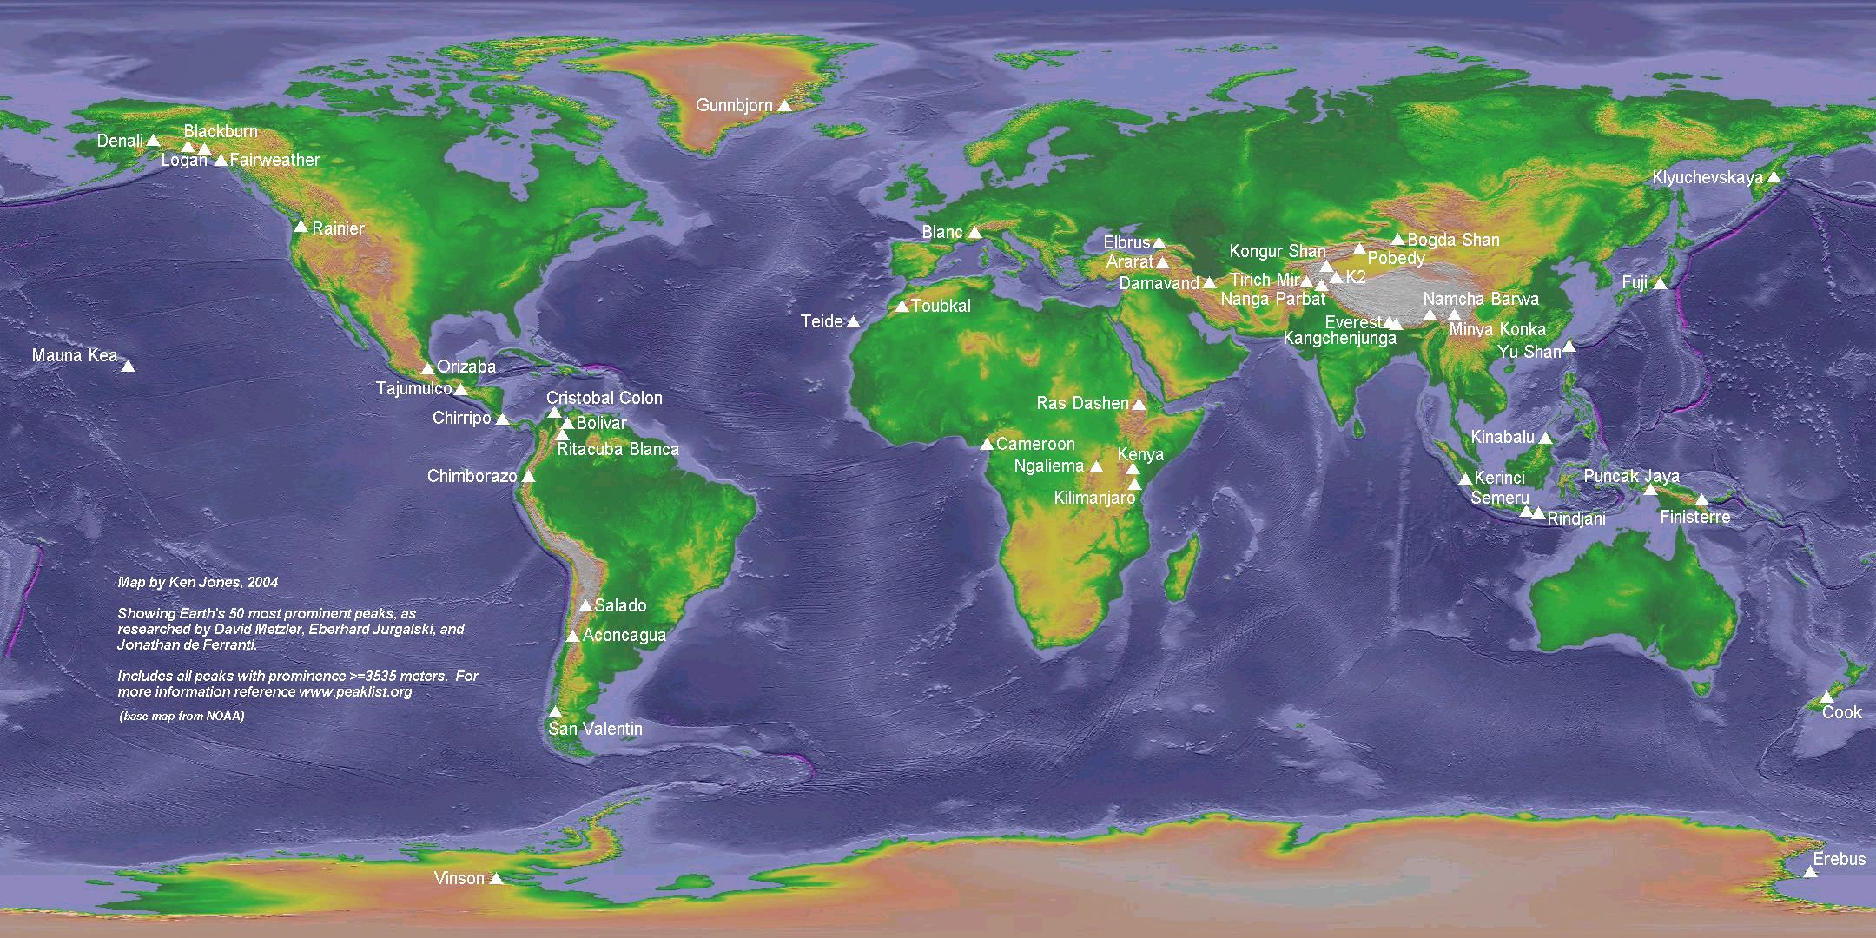
Notes:
This map shows the 50 most prominent peaks in the world.
w/o www.cohp.org

Slide 33
Top 10 peaks by prominence…..
Mount Everest 8,848 m
Anconcagua 6,962 m
Mount McKinley 6,138 m
Mount Kilimanjaro 5,882 m
Pico Cristobal Colon 5,509 m
Mount Logan 5,250 m
Pico de Orizaba 4,922 m
Vinson Massif 4,892 m
Puncak Jaya 4,884 m
Mount Elbrus 4,741 m

Slide 34
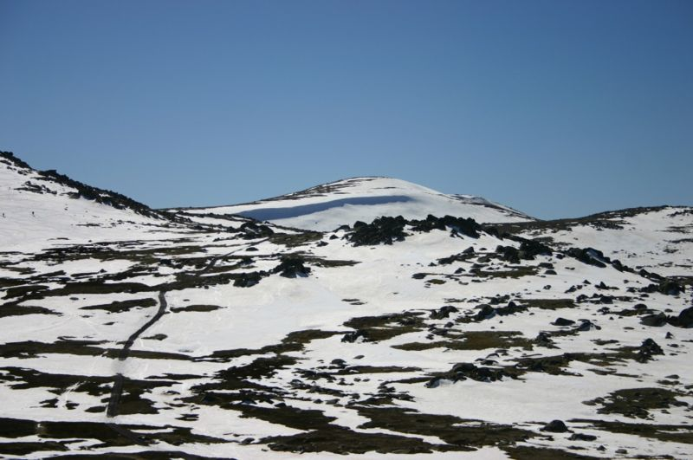
Mount Kosciuszko
Outside the top 125.
2,228 m

Slide 35
Questions ?

